Slide 1
Optimal Design Method of Flexible Excitation System for Improving Power System Stability

Slide 2
Abstract
Providing sufficient damping over the full frequency range of low-frequency oscillation (LFO) is a challenge in modern power systems. The flexible excitation system with two damping channels, controlled by the power system stabilizer (PSS) and the reactive power damping controller (RPDC), respectively, provides a new way to solve this problem. The controller structures of the flexible excitation system are studied, in which a novel structure is adopted in RPDC to enhance the damping over the lower frequency range of LFO. The controller parameters design method of the flexible excitation system is also proposed: the phase compensation method is employed to design the time constants of PSS and RPDC; and the gains of them are adjusted based on their critical values. A single machine-infinite bus system in a real-time digital system and a system considering the doubly-fed wind generator are simulated to verify the effectiveness of the flexible excitation system on improving the power system stability.

Slide 3
Existing System
The computer implementation of such a scheme of economic dispatch is straightforward.
It might be done by provision of tables of the values of FY as a function of the load levels and devising a simple scheme to take the existing load plus the projected increase to look up these data and compute the factors.
Security enhancement: Recommends corrective control actions to be taken to alleviate an existing or potential overload in the system while ensuring minimal operational cost.
The secondary reactor is normally nonexistent, as it is more economical to design the reactor transformer with 200% leakage impedance between primary and secondary windings.

Slide 4
Disadvantage of Existing System
The conic programming is an effective tool to solve robust PSS design problems by simultaneously considering several operating scenarios is show in.
Linear Matrix Inequality (LMI) is flexible in controller design since it provides an incredibly powerful way to solve convex or quasi-convex optimization problems.
A PSS for a small-signal stability study using three kinds of controllers to solve the problem of the immeasurable state variables in the conventional sliding mode control is presented in, which the effectiveness of the proposed controller is verified by linear time-domain simulation under normal load operation and under parameter variation of AVR gain.

Slide 5
PROPOSED SYSTEM :
The modified form of BPTT has been named Recursive Gradient (RG) and has used optimization of an objective function based on the current and previous state vector and control inputs.
The results have proved that neuro-PSS trained on proposed algorithm had far better tracking capability than conventional PSS.
The strength of the proposed controller has been depicted on multi machine system. The results have shown that the proposed controller has performed better in terms of overshoot, undershoot as well as damping.
The research work proposed in [58] has used evolutionary algorithm and ANFIS. The control algorithm is based on self-tuning and offline-trained.

Slide 6
ADVANTAGE
Power system dynamic performance is improved by the damping of system oscillations. Generally, there are two kinds of power oscillation damping controllers in power systems: PSS and FACTS controllers.
PSS is widely used in the electric power industry for improve the performance and functions of power systems during normal and abnormal operations.
A PSS can be viewed as an additional block of a generator excitation control or automatic voltage regulator, added to improve the overall power system dynamic performance, especially for the control electromechanical oscillations.
The gain and the lead-lag compensator time constants are to be selected for optimal performance over a wide range of operating conditions.

Slide 7
TITTLE | AUTHOR | DESCRIPTION
Static Synchronous Compensator for Improving Performance of Power System - A Review | Gh. Shahgholian, J. Faiz, | A review on the state-of-the-art STATCOM technology and further research potential are presented classifying more than 300 research publications.
Damping of Sub-Synchronous Oscillations in Power System Using Static Synchronous Series Compensator | M. Farahani, | The design objective is to suppress the subsynchronous resonance (SSR) caused by the series capacitor.

Slide 8
TITTLE | AUTHOR | DESCRIPTION
Robust Stabilizer of Electric Power Generator Using H¥ with Placement Constraints | M. Bouhamida, M.A. Denai, | This paper deals with the application of robust control theory to the design of electric power system stabilisers.
Review of Conventional Power System Stabilizer Design Methods | A.A. Ba-Muqabel, M.A. Abido, | This paper introduces a review on the techniques applied on the conventional PSS design only.

Slide 9
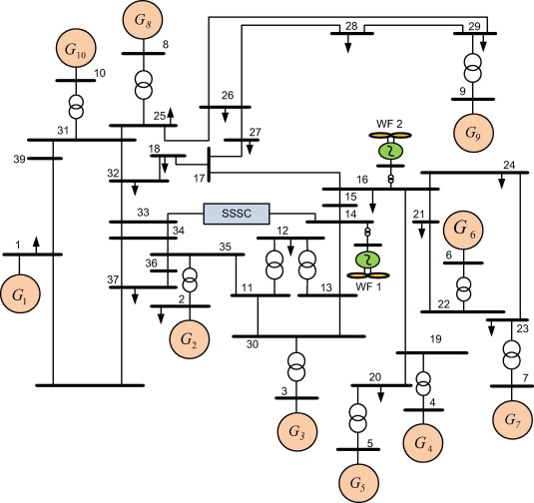
Block Diagram

Slide 10
SOFTWARE REQUIREMENTS:
Operating System : Windows 10
Platform : DOT NET TECHNOLOGY
Front End : ASP.Net 4.0
Back End : SQL SERVER 2014

Slide 11
HARDWARE REQUIREMENTS:
Keyboard
Mouse
Hard disk 500GB
Ram 4 Gb

Slide 12
CONCLUTION
This paper presents a critical review of the recent philosophies in the area of PSS. A simple, economical and effective for improve the steady-state stability margin, increase system positive damping, suppress lowfrequency oscillation of the power system and improve power system dynamic stability is with PSS. It has been widely used in the electric power industry in order to increase the damping ratios of electromechanical modes, extend power transfer limits of system and maintain the reliable operation of the grid.

Slide 13
REFERENCE
[1] Gh. Shahgholian, J. Faiz, “Static Synchronous Compensator for Improving Performance of Power System - A Review”, Int. Rev. of Elec. Eng., Vol. 4, No. 2, pp. 2333-2342, Oct. 2010.
[2] M. Farahani, “Damping of Sub-Synchronous Oscillations in Power System Using Static Synchronous Series Compensator”, IET Gen., Trans. and Dist., Vol. 6, No. 6, pp. 539-544, June 2012.
[3] M. Bouhamida, M.A. Denai, “Robust Stabilizer of Electric Power Generator Using H with Placement Constraints”, Jour. of Elec. Eng. (JEE), Vol. 56, No. 7-8, pp. 176-182, 2005.
[4] A.A. Ba-Muqabel, M.A. Abido, “Review of Conventional Power System Stabilizer Design Methods”, IEEE/GCC, pp. 1-7, Manama, March 2006.
[5] B. Tang, M.L. McAnelly, G. Gu, “Experimental Parameter Tuning of Power System Stabilizer”, IEEE/CCDC, pp. 2132-2137, Taiyuan, May 2012.

Slide 14
[6] J. Murgas, A. Dobrovic, E. Miklovicova, J. Dubravsky, “Two Level Turbogenerator Control System”, Jour. of Elec. Eng., Vol. 55, No. 3-4, pp. 83-88, 2004.
[7] A. Safari, R. Jahani, M. Hajinasiri, A.H. Araskalaei, H.A. Shayanfar, “COA Based Coordinated Design of FACTS and PSS Output Feedback Controllers”, Int. Rev.of Elec. Eng. (IREE), Vol. 5, No. 6, pp. 2803- 2808, Aug. 2010.
[8] H. Taliyat, J. Sadeh, R. Ghazi, “Design of Augmented Fuzzy Logic Power System Stabilizer to Enhance Power System Stability”, IEEE Trans. on Ene. Con., Vol. 11, pp. 97-103, March 1996.
[9] M.O. Hassan, S.J. Cheng, Z.A. Zakaria, “Design and Parameters Optimization of Power System Stabilizer to Improve Power System Oscillations”, IEEE/ICCAE, Vol. 5, pp. 107-111, Singapore, Feb. 2010.
[10] S. Panda, N.P. Padhy, R.N. Patel, “Robust Coordinated Design of PSS and TCSC Using PSO Technique for Power System Stability Enhancement”, Jour. of Elec. Sys., Vol. 3, No. 2, pp. 109-123, 2007.

