Slide 1
On the Impact of Auto-Correlation of Stochastic Processes on the Transient Behavior of Power Systems

Slide 2
Abstract
This letter studies the impact of auto-correlation of stochastic processes on the dynamic response of power systems. The frequency spectrum of the trajectories of the state variables of the system is utilized as a metric to evaluate this impact. The case study considers the well- known two-area system as well as with a 1479-bus dynamic model of the all-island Irish transmission system. Simulation results indicate that the auto-correlation have a direct impact on the amplitude of the dominant electro-mechanical modes of the system. Results also show that, for a wide range of the values of the auto-correlation, the impact of stochastic processes on system dynamics is local, affects differently each area of the system and, in some cases, can lead to instability and voltage collapse.

Slide 3
Existing System
Using this relationship, we compute the expected waiting time of a newly-arrived customer to begin service; this requires that the existing average number of customers be served.
Thus, the waiting time for service is computed as the product of the average number of customers in the system times the average departure time per customer.
While in some cases such processes are local and independent, there exist processes that are intrinsically correlated. For example, in most locations, cloudy days tend to be more windy than clear-sky ones.
Then the variations of the active and reactive power consumption of loads are coupled if the loads have a constant power factor.

Slide 4
Disadvantage of Existing System
Potential dangerous impacts which are intuitive to utilities are line congestion, transformer overloads and other not foreseen problems at the different grid levels, but mainly in distribution grids.
Faced with the growing complexity of the future power grid and the stochastic disturbances caused by renewable energy sources such as PHEVS, wind and solar power, this dissertation deals with the issue of the stability of the power system and has presented contributions in the tools developed and analysis carried out to examine the stability of the power system when stochastic loads and generations are present.
Depending on when and where the vehicles are plugged in, they could cause local or regional constraints on the grid

Slide 5
PROPOSED SYSTEM :
It is important to note that the proposed model can be applied to systems of any order and complexity without the need of any simplifications or assumptions in the original model.
The proposed approach to model correlated SDEs using correlated Wiener processes is presented in describes how to include correlated stochastic processes in power systems.
After that, the model proposed in this paper is capable or generating synthetic noise with the same statistical properties and same correlation.
The proposed approach, thus, does not need to be continuously fed with measurement data. This is, in turn, one of the practical advantages of the proposed method.

Slide 6
ADVANTAGE
The traditional approach to power system stability studies is based on a deterministic transient energy function.
However, such a deterministic analysis does not provide a realistic evaluation of system transient performance where the intermittency and variability of energy production associated with any renewable technology needs to be reflected and accurately modeled in system stability and performance assessments.
Electric motors are inherently more efficient than internal combustion engines; they do not consume energy while vehicles are stationary and they provide the opportunity to recover energy from braking.
Out of this ambience the promise for more efficient individual transportation is partly represented by PHEVs, mitigating vehicle technology to an increased electrification.

Slide 7
TITTLE | AUTHOR | DESCRIPTION
Probabilistic constrained load flow considering integration of wind power generation and electric vehicles | J. G. Vlachogiannis, | The developed stochastic model of EV demand/supply and the wind power generation model are incorporated into load flow studies
Probabilistic load modeling for power system expansion planning | M. B. Do Coutto Filho, A. M. Leite Da Silva, V. L. Arienti, S. M. P. Ribeiro, | The proposed TEP model can find the optimal trade-off between transmission investment and demand response expenses.

Slide 8
TITTLE | AUTHOR | DESCRIPTION
A Stochastic approach to small disturbance stability analysis | C. O. Nwankpa, S. M. Shahidehpour, Z. Schuss, | A systematic approach to the construction of stochastic models of electric power systems for small disturbance stability analysis is presented.
Probabilistic assessment of transient stability in a practical multimachine system | R. Billinton and P. R. S. Kuruganty, | The application of probabilistic techniques in the quantitative evaluation of power system reliability is steadily increasing.

Slide 9
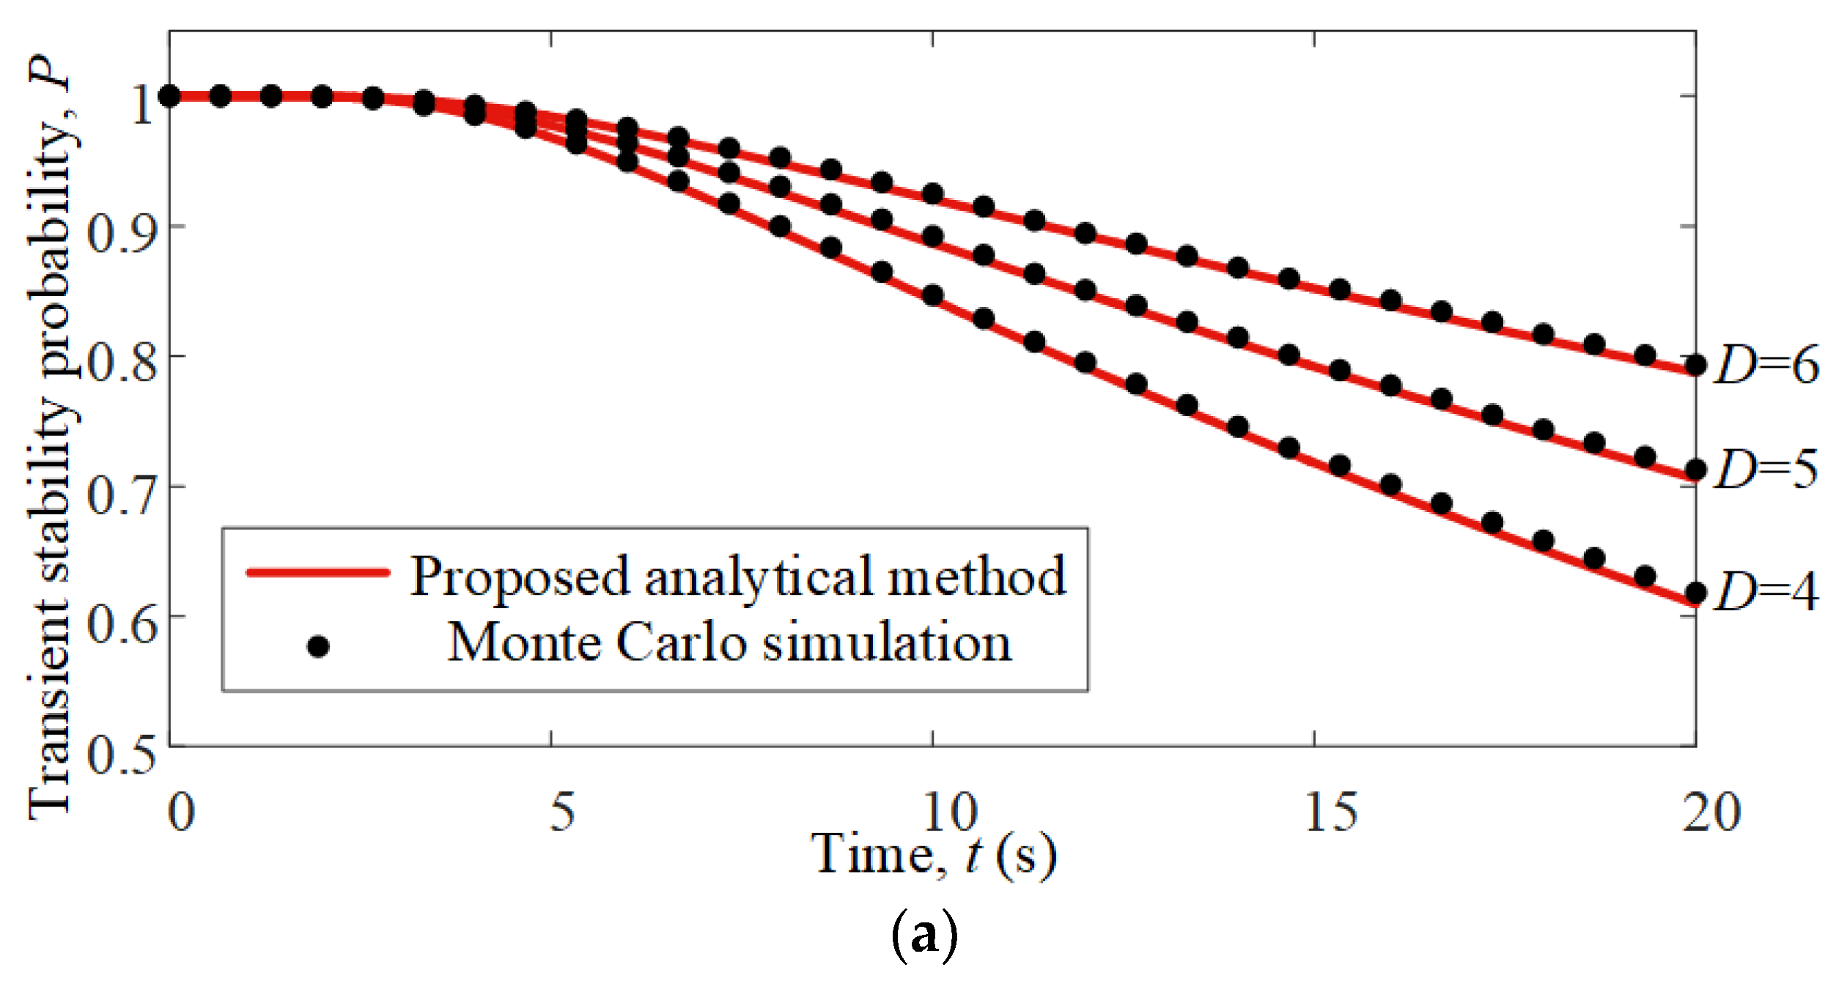
Block Diagram

Slide 10
SOFTWARE REQUIREMENTS:
Operating System : Windows 10
Platform : DOT NET TECHNOLOGY
Front End : ASP.Net 4.0
Back End : SQL SERVER 2014

Slide 11
HARDWARE REQUIREMENTS:
Keyboard
Mouse
Hard disk 500GB
Ram 4 Gb

Slide 12
CONCLUTION
This paper develops an approach to analyze the impact of random load and generation variations on the transient stability of a power system. The well-known energy function method for power system transient stability is used as a basis to explore the stochastic power system stability through a stochastic Lyapunov stability analysis. Further, the method was extended numerically using the Euler-Maruyama method. It was shown that increasing either (or both) the variance and the magnitude of the applied variation can have a destabilizing effect on the power system. This could potentially cause difficulties as more randomness is introduced into the power system through renewable energy sources and plug-in-hybrid vehicles.

Slide 13
REFERENCE
[1] J. G. Vlachogiannis, “Probabilistic constrained load flow considering integration of wind power generation and electric vehicles,” IEEE Trans. on Power Systems, vol. 24, no. 4, Nov. 2009.
[2] M. Meldorf, T. That, J. Kilter, Stochasticity of the Electrical Network Load, Estonian Academy Publishers, 2007.
[3] M. B. Do Coutto Filho, A. M. Leite Da Silva, V. L. Arienti, S. M. P. Ribeiro, “Probabilistic load modeling for power system expansion planning,” IEE Third International Conference of Probabilistic Methods Applied to Electric Power Systems, 1991.
[4] C. O. Nwankpa, S. M. Shahidehpour, Z. Schuss, “A Stochastic approach to small disturbance stability analysis,” IEEE Transactions on Power Systems, vol. 7, no. 4, November 1992.
[5] R. Billinton and P. R. S. Kuruganty, “Probabilistic assessment of transient stability in a practical multimachine system,” IEEE Trans. on Power Apparatus and Systems, vol. 100, no. 7, July 1981.

Slide 14
[6] F. F. Wu and Y-K Tsai, “Probabilistic dynamic security assessment of power systems: Part I - basic model,” IEEE Trans. on Circuits and Systems, vol. 30, no. 3, March 1983.
[7] K. J. Timko, A. Bose, P. M. Anderson, “Monte Carlo simulation of power system stability,” IEEE Trans. on Power Apparatus and Systems, vol. 102, no. 10, Oct. 1983.
[8] H. Mohammed and C. O. Nwankpa, “Stochastic analysis and simulation of gridconnected wind energy conversion system,” IEEE Trans. on Energy Conversion, vol 15, no. 1, March 2000.
[9] J. R. Hockenberry and B. C. Lesieutre, “Evaluation of uncertainty in dynamic simulations of power system models: The Probabilistic collocation method,” IEEE Trans. on Power Systems, vol. 19, no. 3, August 2004.
[10] S. O. Faried, R. Billinton, and S. Aboreschaid, “Probabilistic evaluation of transient stability of a wind farm,” IEEE Trans. on Energy Conversion, vol. 24, no. 3, Sept. 2009.

