Slide 1
VSC-HVDC Interties for Urban Power Grid Enhancement

Slide 2
Abstract
Urban power grids are facing many operational and expansion challenges to meet further demand growth and increased reliability requirements. Advanced transmission technologies have been considered by the electric utilities to effectively increase the utilization of existing infrastructure and operational flexibility. The focus of this paper is on VSC-HVDC technologies for urban power grid enhancement and modernization. First, a potential technical scheme is proposed for converting an existing AC circuit to DC operation, which could boost the power transfer capability of the critical transmission corridor and increase network operational flexibility.

Slide 3
Second, this paper proposes three operation modes for the VSC-HVDC interties in urban power grids corresponding to normal, emergency and island operating conditions, respectively. An integrated, adaptive emergency control strategy (AEC) is proposed that can enable adaptive power flow responses of the VSC-HVDC intertie under varying system operating conditions and critical contingencies. The flexibility and effectiveness of the proposed operational principles of urban VSC-HVDC intertie and the corresponding control strategies are verified in PSCAD/EMTDC using a realistic urban power grid in China.

Slide 4
Existing System
A key constraint in adding transmission capacity to existing AC grid is the requirement to neutralize environmental impact - often making overhead grid extensions impossible.
AC expansion options, both overhead and underground, are often limited by voltage or transient instability problems, risk of increased short circuit levels, impacts of unaccepted network loop flows.
The main argument for promoting dc segmented grid is the increased difficulties with existing large ac grids such as risk of widespread disturbances, transfer capability limitations, and expansion restrictions.
Technical feasibility study has shown improved system reliability and market operations by taking advantages of both ac and dc technologies.

Slide 5
Disadvantage of Existing System
Power-electronics solutions have been suggested to solve specific power quality and other problems in industrial distribution systems.
An uninterruptible power supply (UPS) can provide ’ride-through’ capability against voltage interruptions and dips for small loads.
Power quality problems are issues of priority for owners of industrial plants, grid operators as well as for the general public.
This is not necessarily a problem as sensitive load may be supplied from another part of the system as the large motors.
One of the problems is that the fault current in the downstream ac system is limited by the converters.

Slide 6
PROPOSED SYSTEM :
This paper reviews the recent development in HVDC transmission technologies and discusses the needs of the hybrid AC/DC grid structure for future power systems.
The focus is on the benefits of embedded VSC-HVDC transmission systems in meshed ac grid for secure and efficient power delivery.
The paper also discusses how the hybrid AC/DC transmission system together with the wide area measurement system (WAMS) could effectively manage the overall power grid operation security and efficiency.
As such the environmental impact of HVDC is more favorable than ac lines because less right-of-way land is needed.

Slide 7
ADVANTAGE
The influence of the current limitation on the performance is studied. It is shown that VSC-HVDC applied to industrial systems is able to mitigate voltage dips. it is also shown that the rating of the dc link significantly influences its ability to mitigate voltage dips.
The performance during a voltage dip depends significantly on the behavior of the control system when current limitation is activated. The strategy for using the limited amount of current depends on the type of application of the dc link.
Different control strategies are studied and corresponding dynamic performance under step changes and different types of faults is investigated in PSCAD/EMTDC simulation package.

Slide 8
TITTLE | AUTHOR | DESCRIPTION
Power Electronics for Mitigation of Voltage Sags and Improved Control of ac Power Systems | M. M. de oliveira. | This paper presents a review of some the disturbances, on the source side that may cause problems on the load side.
Introducing custom power | Hingorani and N.G. | The term describes the value-added power that electric utilities and other service providers will offer their customers in the future.

Slide 9
TITTLE | AUTHOR | DESCRIPTION
Power electric control in electrical system | E.Acha, V.G. Agelidis, O.Anaya-lara, and T.J.E. Miller. | The term power theory of circuits can be understood as the state of knowledge on their power properties.
Understanding power quality problems: voltage sags and interruptions | M.H.J. Bollen. | This is the first book to offer in-depth analysis of voltage sags and interruptions and to show how to apply mathematical techniques for practical solutions to these disturbances.

Slide 10
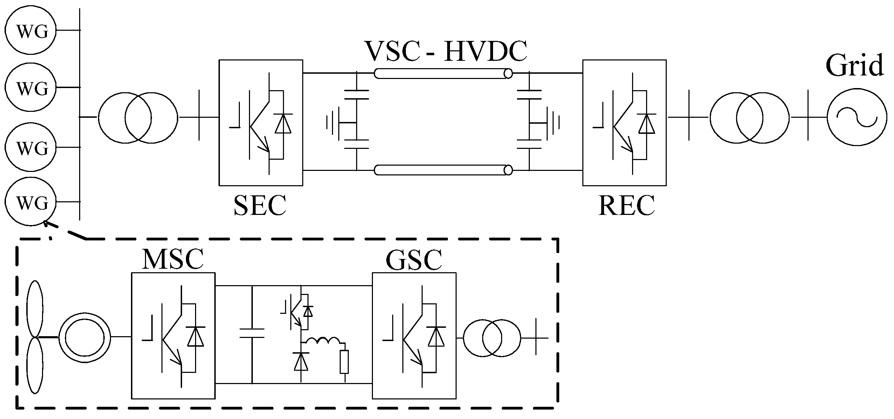
Block Diagram

Slide 11
SOFTWARE REQUIREMENTS:
Operating System : Windows 10
Platform : DOT NET TECHNOLOGY
Front End : ASP.Net 4.0
Back End : SQL SERVER 2014

Slide 12
HARDWARE REQUIREMENTS:
Keyboard
Mouse
Hard disk 500GB
Ram 4 Gb

Slide 13
CONCLUTION
A model of a VSC-HVDC system and different control strategies are presented in this thesis. Two different control strategies are described and implemented in PSCAD/EMTDC. A comparison between an ac grid supplying a passive industrial system and a dc link supplying the same industrial system has been done by using PSCAD/EMTDC. Investigations of some possible applications of the dc medium-voltage system have been modelled and evaluated.

Slide 14
REFERENCE
[1] M. M. de oliveira. Power Electronics for Mitigation of Voltage Sags and Improved Control of ac Power Systems. PhD thesis, Ph.D. thesis, Royal Institute of Technology, ISSN-1100-1607, TRITA-EES-0003, Stockholm, Sweden, 2000.
[2] Hingorani and N.G. Introducing custom power. IEEE Spectrum, 1995.
[3] E.Acha, V.G. Agelidis, O.Anaya-lara, and T.J.E. Miller. Power electric control in electrical system. Newnes, 2002.
[4] M.H.J. Bollen. Understanding power quality problems: voltage sags and interruptions. IEEE Press, New York, 2000.
[5] N.G.Hingorani L.gyugyi. Understanding FACTS. IEEE Press, New york, 2000.

Slide 15
[6] A Ghosh and G Ledwich. Power quality enhancement using custom power devices. Uluwer Academic Publishers, 2002.
[7] Jos Arrillaga. High Voltage Direct Current Transmission. The Institution of Electrical Engineers, 1998.
[8] Dennis A. Woodford. Hvdc transmission. Technical report, Manitoba HVDC Research Centre, 1998.
[9] Roberto Rudervall, J.P. Charpentier, and Raghuveer Sharma. High voltage direct current (hvdc)transmission systems technology review paper. In Energy Week 2000, 2000.
[10] Kjell Eriksson. Operational experience of hvdc light. AC-DC Power Transmission, 2001.

