Slide 1
General Steady-State Modeling and Linearization of Power Electronic Devices in AC-DC hybrid Grid

Slide 2
Abstract
Power electronic devices are important in the modern power system. Control functions and operational characteristics of power electronic devices bring higher nonlinearity and heavier calculation burden for power system analysis, especially in optimization problems. In this paper, a general steady-state model of power electronic devices in the AC-DC hybrid grid is proposed, which considers the high voltage direct current (HVDC) connections and the flexible AC transmission systems (FACTS). Power electronic devices are equivalently represented by impedance, transformers, and controlled sources. The linearized steady-state model is derived and then the specific formulation with minimized error is presented. The effectiveness of the proposed method is verified by optimal power flow (OPF) calculation in the IEEE and Polish test systems.

Slide 3
Existing System
This quick start guide explains to the user how to manipulate an already existing Excel spreadsheet to create different models.
It is required that the user is familiar with editing sheets in Excel and the user at least know how to open MATLAB and run an already existing script (m-file).
Other penalty functions such as the log-barrier method utilized in solving the interior point method also exist.
Therefore, all solutions found were within the desired limits. Were there not a solution within these constraints, the solver would fail by design, since no exists.

Slide 4
Disadvantage of Existing System
Decentralized control is less susceptible to network security problems; however, it does not allow for collaboration among resources which can result in a sub-optimal operating point.
The genetic algorithm is inherently a method for unconstrained optimization. However, as discussed in , modifications may be made to this method in order for it to be applied to the constrained problem.
The genetic algorithm (GA) consists of 3 major processes: reproduction (selection), crossover, and mutation.
Members are able to independently search while at the same time sharing information with other members of the flock. Each individual within the group represents a potential solution to the problem.

Slide 5
PROPOSED SYSTEM :
The proposed method is found to quickly and accurately calculate the optimal power flow and reject solutions that violate the inequality constraints beyond some specified tolerance.
While optimizations were not addressed directly in this dissertation, the proposed modeling approach offers tools optimization of system operation.
The HSSPFC method proposed in this chapter for VSR control is more versatile in that in the event of a loss of communication with the grid, it can continue operate without any loss of performance.
In order to achieve this, a modified P&O method is proposed where the voltage is adjusted until the power moves back into the feasible region.

Slide 6
ADVANTAGE
Therefore, by simplifying control loops and converters, this paper proposes a simplified model for the microgrid system power flow and the dynamic response under exposure to a fault.
The mathematical model equivalent simplification method is used in this paper. This method is concise and efficient and does not rely on the performance of a computer or change the program algorithm of the software.
The simplified model was built based on PSCAD (Power System Computer Aided Design) simulation software and was carried out under short circuit fault conditions to verify its validity.
Through the mathematical model equivalent simplification method, there is no need to apply a new program or algorithm. The reduction of the amount of simulation data can reduce the dependence on the performance of the computer

Slide 7
TITTLE | AUTHOR | DESCRIPTION
Comprehensive evaluation of AC/DC hybrid microgrid planning based on analytic hierarchy process and entropy weight method | Zhao, G.; Wang, D. | The comprehensive evaluation of AC/DC hybrid microgrid planning can provide reference for the planning of AC/DC hybrid microgrids
Research on distributed power capacity and site optimization planning of AC/DC hybrid micrograms considering line factors | Pan, H.; Ding, M.; Chen, A.; Bi, R.; Sun, L.; Shi, S. | This paper presents a collaborative planning method for distributed generation access to AC/DC distribution (micro) grids.

Slide 8
TITTLE | AUTHOR | DESCRIPTION
Research on hybrid microgrid based on simultaneous AC and DC distribution network and its power router | Gai, X.; Wang, Y.; Chen, R.; Zou, L. | The main object is to emphasize the possibility of simultaneous ac-dc transmission with its inherent advantage of power flow control.
Robust frequency and voltage stability control strategy for standalone AC/DC hybrid microgrid | Asghar, F.; Talha, M.; Kim, S.H. | This might cause large frequency and voltage deviations in the system due to unpredictable output power fluctuations.

Slide 9
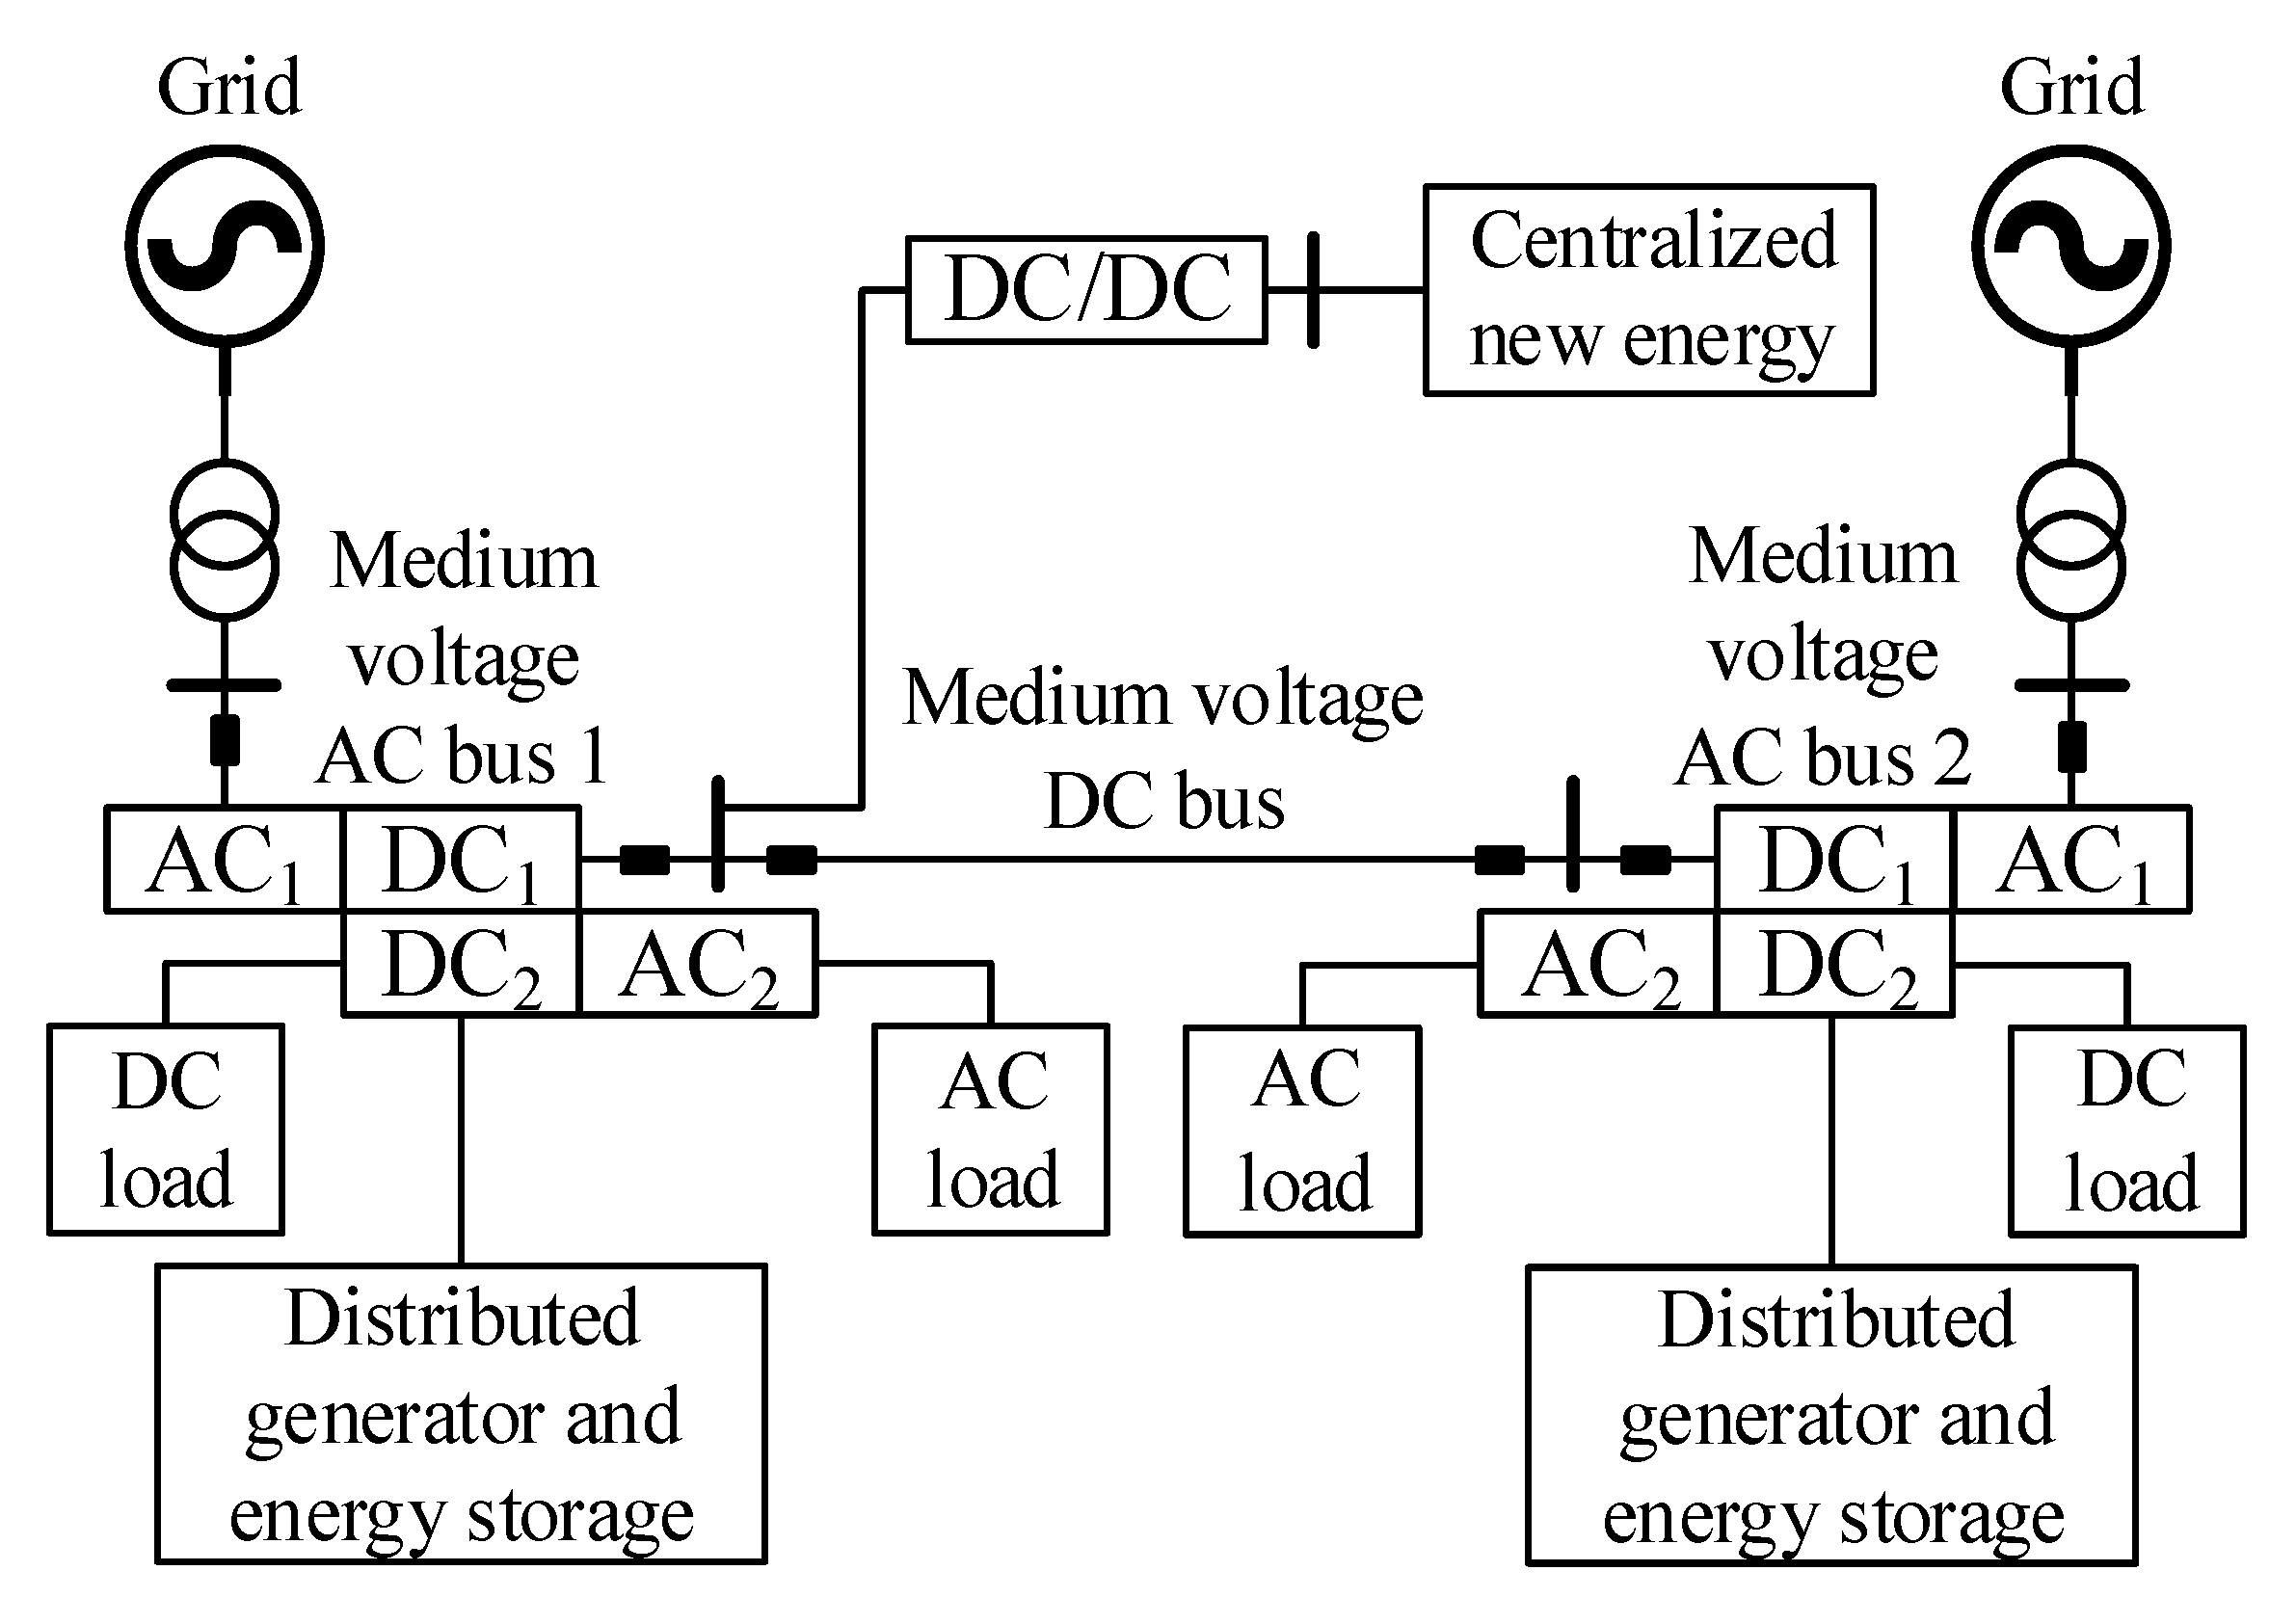
Block Diagram

Slide 10
SOFTWARE REQUIREMENTS:
Operating System : Windows 10
Platform : DOT NET TECHNOLOGY
Front End : ASP.Net 4.0
Back End : SQL SERVER 2014

Slide 11
HARDWARE REQUIREMENTS:
Keyboard
Mouse
Hard disk 500GB
Ram 4 Gb

Slide 12
CONCLUTION
In the view of the low efficiency of electromagnetic simulation of the AC/DC hybrid microgrid, this paper proposes a simplified AC/DC hybrid model. Following the model simulation verification of this paper, the following conclusions can be made: 1. In the AC/DC hybrid microgrid model, the microgrid network, except for the generators, was taken as the research object. This model transforms the response time scale to milliseconds, simplifies the converter and its control system, and applies controllable power sources to replace the converter. 2. Through the mathematical model equivalent simplification method, there is no need to apply a new program or algorithm. The reduction of the amount of simulation data can reduce the dependence on the performance of the computer. 3. The simplified model proposed in this paper improves the simulation efficiency, the output characteristics of which maintain good consistency with those of the detailed model under AC or DC load side fault conditions. 4. The simplification of this paper is for each rectifier or inverter module connected by the power balance relationship. It could be applied to other more complex network topologies including more modules.

Slide 13
REFERENCE
1. Zhao, G.; Wang, D. Comprehensive evaluation of AC/DC hybrid microgrid planning based on analytic hierarchy process and entropy weight method. Appl. Sci. 2019, 9, 3843. [CrossRef]
2. Pan, H.; Ding, M.; Chen, A.; Bi, R.; Sun, L.; Shi, S. Research on distributed power capacity and site optimization planning of AC/DC hybrid micrograms considering line factors. Energies 2018, 11, 1930. [CrossRef]
3. Gai, X.; Wang, Y.; Chen, R.; Zou, L. Research on hybrid microgrid based on simultaneous AC and DC distribution network and its power router. Energies 2019, 12, 1077. [CrossRef]
4. Asghar, F.; Talha, M.; Kim, S.H. Robust frequency and voltage stability control strategy for standalone AC/DC hybrid microgrid. Energies 2017, 10, 760. [CrossRef]
5. Baek, J.; Choi, W.; Chae, S. Distributed control strategy for autonomous operation of hybrid AC/DC microgrid. Energies 2017, 10, 373. [CrossRef]

Slide 14
6. Brando, G.; Bova, B.; Cervone, A.; Dannier, A.; Del Pizzo, A. A distribution power electronic transformer with MMC. Appl. Sci. 2018, 8, 120. [CrossRef]
7. Shi, S.M.; Wang, X.F.; Zhong, F. The research of typical control strategy of electronic power transformer in parallel operation. In Proceedings of the IEEE Advanced Information Management, Communicates, Electronic and Automation Control Conference (IMCEC), Xi’an, China, 3–5 October 2016.
8. Duan, Q.; Wang, J.H.; Ma, C.Y. Flexible power distribution unit—A novel power electronic transformer development and demonstration for distribution system. In Proceedings of the IECON 41st Annual Conference of the IEEE Industrial Electronics Society, Yokohama, Japan, 9–12 November 2015.
9. Zhu, M.L.; Geng, S.B.; Li, Y.G. Protected control strategies for voltage-source-converter (VSC) under grid faults in AC/DC hybrid grid. In Proceedings of the International Power Electronics and Application Conference and Exposition, Shanghai, China, 5–8 November 2014.
10. Yang, J.; John, E.F.; John, O. Short-circuit and ground fault analyses and location in VSC-based DC network cables. IEEE Trans. Ind. Electron. 2012, 59, 3827–3837. [CrossRef]

