Slide 1
Adaptive Power Point Tracking Control of PV System for Primary Frequency Regulation of AC Microgrid with High PV Integration

Slide 2
Abstract
With the increasing integration of PV generation in AC microgrids, it is challenging to keep the stability of system frequency due to the intermittent and stochastic nature of PVs. Thus, in order to reduce the investment and maintenance costs of storage systems, the electric utility has shown increasing interest in calling on PVs to provide frequency regulation services. In this paper, a novel sliding mode control (SMC) based adaptive power point tracking (APPT) control strategy is proposed to provide bi-directional primary frequency regulation (BPFR) of an AC microgrid.

Slide 3
In this strategy, in order to restrain the variation of frequency, the sliding mode surface is adaptively regulated to provide an adaptive power reserve. Thus, the PVs will have a power headroom to regulate the frequency both up and down through releasing the reserved power or increasing the reserves of the PV systems. Furthermore, the sliding mode surface is adaptively regulated only based on the locally measured frequency of the microgrid without the requirements of communication, detailed PV model, irradiance sensors as well as MPP estimators. Thus, the proposed control strategy shows the advantages of easy to implement and reduces the investment and maintenance costs of installing storage systems or irradiance sensors.

Slide 4
Existing System
The flexibility of the proposed adaptive FPPT algorithm has been demonstrated experimentally on a 3-kVA laboratory setup under different conditions.
The tracking error of the proposed algorithm has been reduced significantly in all experimental tests, while the settling has also been decreased.
The results demonstrated the applicability and effectiveness of the proposed FPPT algorithm as an additional function for existing MPPT algorithms in GCPVPPs.
Therefore, the existing maximum power point tracking algorithms in GCPVPPs, should be replaced by flexible power point tracking (FPPT) algorithms in GCPVPPs in order to comply with these demands.

Slide 5
Disadvantage of Existing System
In this method, first, the problems are expressed in an optimisation process, then a controller is applied to solve the problems .
The controller suffers from chattering problems. Therefore, the SMC parameters are optimised based on output ripple waves to overcome this issue; and an extra integral term of the grid current is added to the sliding surface to eliminate tracking errors.
To overcome these problems, different control approaches are proposed in the literature with their relative advantages and disadvantages.
Moreover, the problem of reactive power sharing is solved in this method as frequency is a global parameter, which is used in controlling reactive power.

Slide 6
PROPOSED SYSTEM :
In this paper, an adaptive FPPT algorithm is thus proposed, which features fast dynamics under rapidly changing environmental conditions (e.g., due to passing clouds), while maintaining low power oscillations in steady-state.
The proposed algorithm is an adaptation of the P&O method considering the P-V characteristics of PV panels.
In the proposed algorithm, the operation mode of the converter and the current operation point of the PV panel are considered in the calculation of the voltage-step in each calculation step.
The proposed FPPT algorithm in this paper can also be used to extract the maximum power from the PV strings, while it is able to limit the PV power to a required value upon demands.

Slide 7
ADVANTAGE
The primary control in microgrids has several roles, including: enhancing system performance and stability, maintaining the voltage and frequency stability, offering plug and play features of DG units, ensuring accurate power sharing in the presence of linear and non-linear loads, and eliminating circular current.
A transformation of the controlled parameters is, sometimes, essential to improving a controller performance.
The effective dynamic performance of the deadbeat (DB) predictive controller facilitates the current control of an inverter.
The self-learning feature of the NN algorithm gives feasibility and easy design for different operating conditions and grid disturbances, and augmenting a robust control performance

Slide 8
TITTLE | AUTHOR | DESCRIPTION
MOD-DR: Microgrid optimal dispatch with demand response | Jin, M.; Feng, W.; Liu, P.; Marnay, C.; Spanos, C. | The key contribution of this paper is the formulation of a multi-objective optimization with prevailing constraints and utility trade-off based on the model of a large-scale MG with flexible loads, which leads to the derivation of strategies that incorporate uncertainty in scheduling.
Present energy scenario and potentiality of wind energy in Bangladesh | Hossain, M.A.; Ahmed, M.R. | Among various form of renewable energy, wind energy is one of most potential source.

Slide 9
TITTLE | AUTHOR | DESCRIPTION
Microgrid to enable optimal distributed energy retail and end-user demand response | Jin, M.; Feng, W.; Marnay, C.; Spanos, C. | This study investigates the pricing and operation strategy with DR for a MG retailer in an integrated e.nergy system (IES)
Primary Voltage Control of a Single-phase Inverter using Linear Quadratic Regulator with Integrator | Hossain, M.A.; Azim, M.I.; Mahmud, M.A.; Pota, H.R. | The combined integral term assists to recover the voltage difference between grid and reference grid voltage.

Slide 10
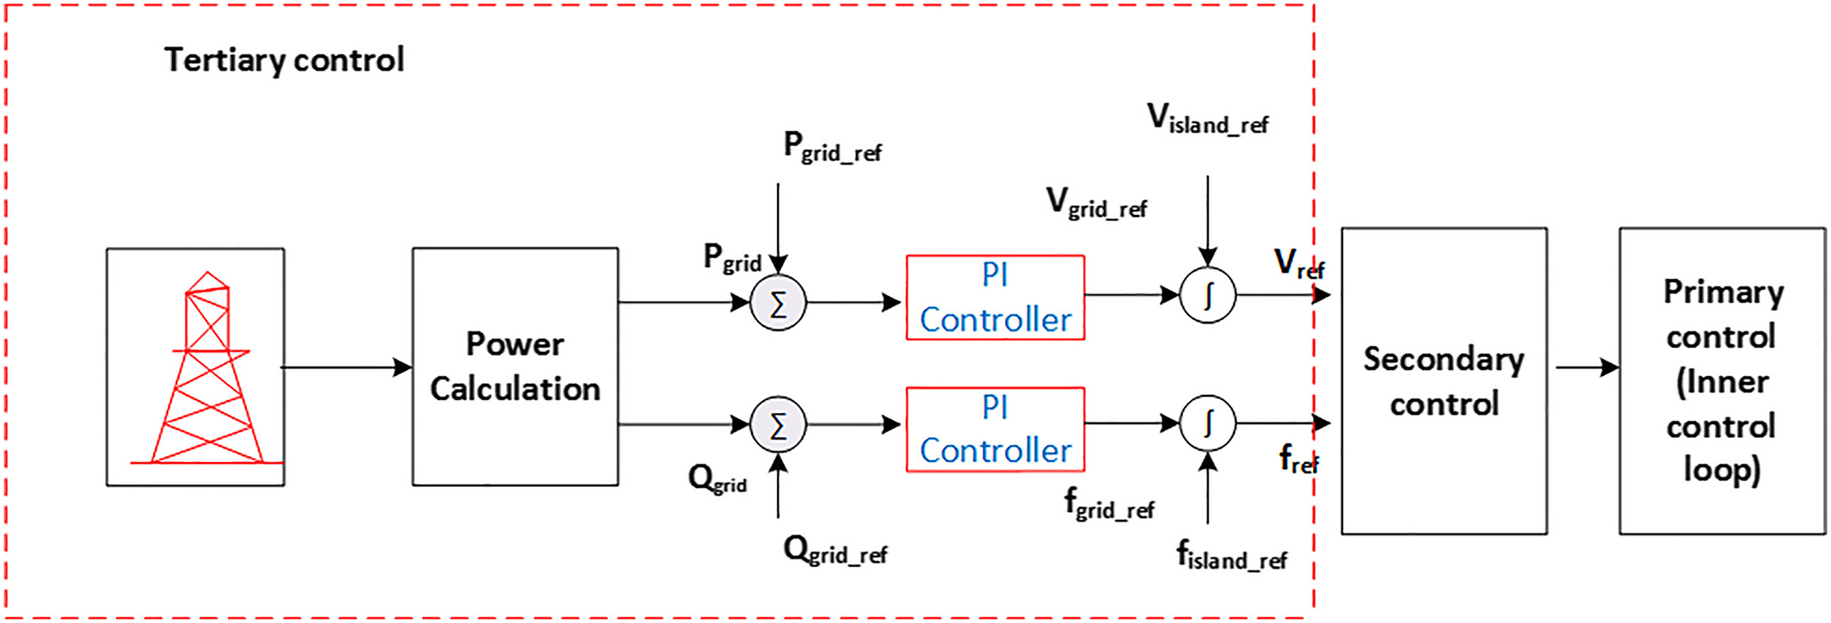
Block Diagram

Slide 11
SOFTWARE REQUIREMENTS:
Operating System : Windows 10
Platform : DOT NET TECHNOLOGY
Front End : ASP.Net 4.0
Back End : SQL SERVER 2014

Slide 12
HARDWARE REQUIREMENTS:
Keyboard
Mouse
Hard disk 500GB
Ram 4 Gb

Slide 13
CONCLUTION
This paper presents a technical overview of different control techniques for DG units in an islanded microgrid. The aim of this research is to provide a detailed and thorough review of different control levels of microgrids which is very important in the development of smart microgrids. The historical development of the control methods used in the power industry and those reported in the literature is documented. The key discussions are divided into two parts: inner-loop controls and primary controls without communication. It is realised from the literature review on inner-loop controllers that the acceptability of suitable inner-loop controls for DG units completely depends on the microgrid characteristics. For example, if microgrid parameters are sensitive, robust controllers for voltage control are preferable. In addition, if the harmonics are in a concern, certain controllers are able to address this, e.g., resonant and predictive controllers, compared with others like PI controller.

Slide 14
REFERENCE
1. Jin, M.; Feng, W.; Liu, P.; Marnay, C.; Spanos, C. MOD-DR: Microgrid optimal dispatch with demand response. Appl. Energy 2017, 187, 758–776.
2. Hossain, M.A.; Ahmed, M.R. Present energy scenario and potentiality of wind energy in Bangladesh. World Acad. Sci. Eng. Technol. 2013, 7, 1001–1005.
3. Jin, M.; Feng, W.; Marnay, C.; Spanos, C. Microgrid to enable optimal distributed energy retail and end-user demand response. Appl. Energy 2017, doi:10.1016/j.apenergy.2017.05.103.
4. Hossain, M.A.; Azim, M.I.; Mahmud, M.A.; Pota, H.R. Primary Voltage Control of a Single-phase Inverter using Linear Quadratic Regulator with Integrator. In Proceedings of the 2015 Australasian Universities Power Engineering Conference (AUPEC), Wollongong, Australia, 27–30 September 2015.
5. Han, H.; Hou, X.; Yang, J.; Wu, J.; Su, M.; Guerrero, J.M. Review of power sharing control strategies for islanding operation of AC microgrids. IEEE Trans. Smart Grid 2016, 7, 200–215.

Slide 15
6. Vandoorn, T.; De Kooning, J.; Meersman, B.; Vandevelde, L. Review of primary control strategies for islanded microgrids with power-electronic interfaces. Renew. Sustain. Energy Rev. 2013, 19, 613–628.
7. Bidram, A.; Davoudi, A. Hierarchical structure of microgrids control system. IEEE Trans. Smart Grid 2012, 3, 1963–1976.
8. Hossain, M.A.; Azim, M.I.; Mahmud, M.A.; Pota, H.R. Active power control in an islanded microgrid using DC link voltage status. In Proceedings of the 2015 IEEE Innovative Smart Grid Technologies-Asia (ISGT ASIA), Bangkok, Thailand, 3–6 November 2015; pp. 1–6.
9. Chung, H.S.H.; Wang, H.; Blaabjerg, F.; Pecht, M. Reliability of Power Electronic Converter Systems; The Institution of Engineering and Technology: London, UK, 2016.
10. Mohan, N.; Undeland, T.M. Power Electronics: Converters, Applications, and Design; John Wiley & Sons: Hoboken, NJ, USA, 2007.

