Slide 1
E-Learning Management System And
Timetable Management System

Slide 2
ABSTRACT :
The rapid development of e-learning and the use of LMS (moodle) have triggered some universities and schools in Indonesia to develop e-learning. However, most of their e-learning materials or contents still underuse the powerful features available in the LMS. The powerful features of the LMS are described and discussed along with their educational principles. This paper has elaborated the digital
materials (content) development based on the writer’s experience in developing .
e-learning website In designing digital material development; preplanning, planning, online material development consideration, mapping the work, content designed and writing, material development, testing and final checking and evaluation are essential steps to produce good educational e-learning.

Slide 3
Time Table Management system is an automated system which generates Time table according to the data given by the user. The main requirement of the application is to provide the details about the branch, subjects, number of labs, total number of period and details about the lab assistance. Then the Application generates the time table according to the need. The problem is to design and implement an algorithm to create a semester course time table by assigning time-slots and rooms to a given set of courses to be run that semester under given constraints. The constraints include avoiding clashes of time-slots and rooms, assigning appropriate rooms and appropriate number of slots and contact hours to the courses etc.

Slide 4
Existing System:
The current situation is very limited to few resources, students are unable to get knowledge more than that the lecture provides to them.
This in the end limits student’s performances, because everything a student gets is collected from lectures in class. Here are some of the problems of the current system.

Slide 5
  In the existing system only a crime can be reported, also it has more workload for the authorized person, but in the case of Proposed System, the user can register the site and send the first information report or complaint about a particular situation or person.

Slide 6
Drawback :
No self-discipline
No face-to-face interaction
Lack of flexibility
Lack of input from trainers
Slow evolution
Good e-learning is difficult to do.
More man power.
Time consuming.
Consumes large volume of paper work.
Needs manual calculations.
No direct role for the higher officials.

Slide 7
Proposed Work :
Proposed solution is a website and it works as an alternative to the current timetable management system. We used Milestone approach as our research methodology. As the initial step, proper investigation could be launched about the current timetabling system with the interviews of timetable administrator, lecturers and students.
As a result, pros and cons of that system could be clearly analyzed. Then, we conducted an appropriate literature survey of others work with referred to this subject to make an improved problem definition, find out technology to be used and solution. Afterwards, overall research design was constructed. Then, our TMSFIT was developed using several tools such as PHP, MYSQL, Yii, Wamp Server and some more. Consequently, we implemented, deployed and evaluated that new system using campus promises.

Slide 8
The aim of proposed system is to develop a system of improved facilities. The proposed system can overcome all the limitations of the existing system. The existing system has several disadvantages and many more difficulties to work well. The proposed system tries to eliminate or reduce these difficulties up to some extent. The proposed system will help the user to reduce the workload and mental conflict.

Slide 9
ADVANTAGES :
Organizes eLearning content in one location
Provides unlimited access to eLearning materials
Easily tracks learner progress and performance
Reduces Learning and Development cost
Reduces Learning and Development time
Save time and efforts
Reduces error
Secure and user-friendly
Easy customization
Smooth integration
Easy calculation
Paperless environment

Slide 10
Literature Review
TITLE | AUTHOR | CONCEPT
Student modeling for a web-based self-assessment system. | Antal, M., and Koncz, S. (2011) | In the context of self-assessment, the prevalent approach was to open the student models to students, visualize students' progress, and measure students' self-reflection on their own skill mastery.
Research Design and Methodology. In Cross-Cultural Management and Quality Performance. | Babatunde, Y., and Low, S. P. (2015) | This chapter also summarizes the research design and methodology adopted in the study, potential findings, significance and contributions as well as the structure of the book.

Slide 11
TITLE | AUTHOR | CONCEPT
“A university timetabling system based on graph colouring and constraint manipulation,” . | E. K. Burke, D. G. Elliman, and R. Weare, | The problem of constructing an automated system for use with timetabling is particularly well known. Many programs exist for this task, but they perform well only in particular, isolated environments.
“University timetabling through conceptual modeling,”. | J. Lee, S.-P. Ma, L. F. Lai, N. L. Hsueh, and Y.-Y. Fanjiang, | University timetable construction is hardworking and complicated task when there are large number of course arrays and limited resources.

Slide 12
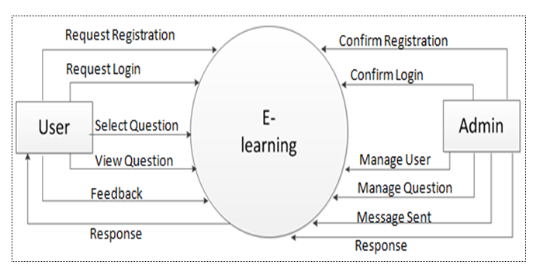
SYSTEM ARCHITECTURE

Slide 13
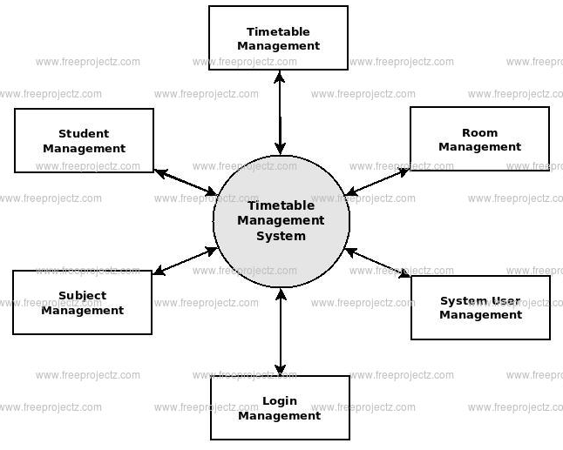

Slide 14
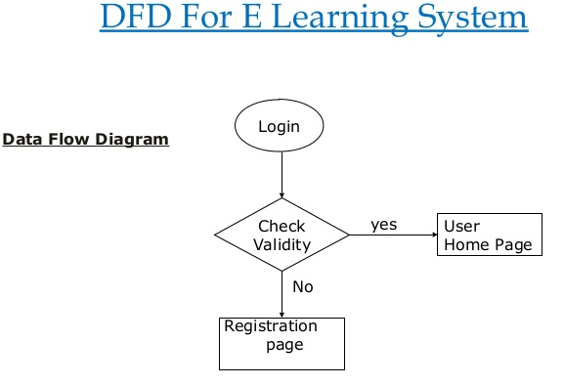
DATA FLOW DIAGRAM

Slide 15
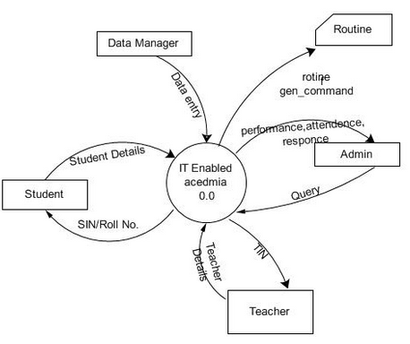

Slide 16
Hardware Requirements:
1. Pentium(R) Dual-Core CPU.
2. 512 MB RAM for windows XP/windows7/windows8.
3. 20 GB HDD.

Slide 17
Software Requirements:
1. FRONTEND:- PHP Version 5.2.6.
2. BACKEND:- My SQL.
3. BROWSER:- Google Chrome & Mozilla Firefox.

Slide 18
References
Antal, M., and Koncz, S. (2011) Student modeling for a web-based self-assessment system.
Babatunde, Y., and Low, S. P. (2015) Research Design and Methodology. In Cross-Cultural Management and Quality Performance. .
Bergin, S., and Reilly, R. (2005) The influence of motivation and comfort-level on learning to program.
Emelyanova, N., and Voronina, E. (2014) Introducing a Learning Management System at a Russian University: Students’ and Teachers’ Perceptions. International Review of Research in Open and Distance Learning, .

Slide 19
E. K. Burke, D. G. Elliman, and R. Weare, “A university timetabling system based on graph colouring and constraint manipulation,” .
D. Datta, K. Deb, and C. M. Fonseca, “Solving class timetabling problem of IIT Kanpur using multi-objective evolutionary algorithm,”.
. J. Lee, S.-P. Ma, L. F. Lai, N. L. Hsueh, and Y.-Y. Fanjiang, “University timetabling through conceptual modeling,”.
. A. Chowdhary, P. Kakde, S. Dhoke, S. Ingle, R. Rushiya, and D. Gawande, “TIMETABLE GENERATION SYSTEM,”.

Slide 20
MODULE
1. Admin
2.Staff
3.Student
4.Today lesson
5.Command

Slide 21
Admin Module
This helps admin to configure courses, products and their price and duration. In this admin can assign different resources to different courses.
This helps admin to manage the registration of partners, teachers and students.
Staff Module
With e-learning, it is very easy to customize the modules according to the need of an individual. The learning process can be paced accordingly as well, and every member can compare her/his progress with the ideal time taken to understand a concept. Post classroom training, learners can still access online courses as per their convenience, thus not conflicting with other time-sensitive tasks that they are required to perform while on the job

Slide 22
Student Module
Dashboard : The dashboard gives a quick look at the progress of the student, where he lacks, which are his strong subjects, which he needs to work on, how many assignments he has completed, what are his scores etc and also his subscription info.
Methodology : Brilliant Learning Management System platform offer unique Methodology for online preparation. It access the student through Assessment test and generate study plan based on the assessment. System track the student progress and can generate Score projection and learning history.

Slide 23
Today lesson
The module to store and set basic lesson fulfillment parameters such as score, attempts, time, ... Upload of Internal test editor, Skill Gaps and Internal Announcements, PDF, VIDEO and files is supported. You may also decide to make a lesson visible to all other system entitled users to reuse it, which means they don’t need to create their own and saves their time.
Command
Monitoring of user activity is done via reporting module where all the content data are shown and listed to lines, where each line represents the lesson entry. This detailed view enables you to see all the lesson parameters details and decide where to pay attention in future user development. You may filter the data by using full text filters and get results within few seconds. Same time you may use the csv file export and make your own analytics in MS Excel or other compatible, which gives you outstanding chance perfectly aim your goal and improve results very fast.

Slide 24
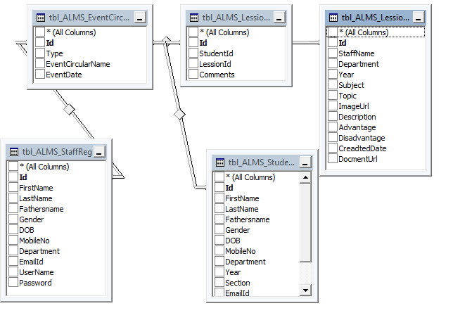

Slide 25
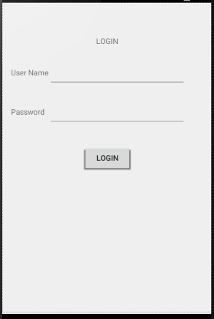

Slide 26


