Slide 1
Damping Power System Electromechanical Oscillations Using Time Delays

Slide 2
Abstract
This paper proposes to utilize intentional time delays as part of controllers to improve the damping of electromechanical oscillations of power systems. Through stability theory, the control parameter settings for which these delays in Power System Stabilizers (PSSs) improve the small signal stability of a power system are systematically identified, including the key parameter settings for which stability regions in the parameter plane remain connected for effective operation. The paper shows that PSSs with two control channels can be effectively designed to achieve best damping characteristics for a wide range of delays. Analytical results are presented on the One-Machine Infinite-Bus (OMIB) electromechanical power system model. To demonstrate the opportunities in more realistic dynamic models, our results are then implemented via numerical analysis on the IEEE standard 14-bus system

Slide 3
Existing System
The use of a raw measurements from PMUs can lead to ambiguous results due to: 1) possible errors in some of the measured samples, 2) ill conditioned autocovariance matrices in the case of PMUs with high sampling rates (30Hz or more) or 3) existing trends in the signal which do not carry any information about system dynamics .
Because of these difficulties, before applying any of the spectral estimators, available data must be preprocessed.
This section analyzes the impact that forced oscillations in PMU data have on damping estimation algorithms, which has been neglected up to now. Several examples are shown where forced oscillations corrupt the accuracy of existing mode meter algorithms.

Slide 4
Disadvantage of Existing System
A remedy to the above issue is to recognize that the characteristic roots of the system vary on the complex plane in a continuum as the delay parameter changes in a continuum .
These oscillations will show up as narrow band oscillations in PSDs and spectrograms, and if superimposed over a real system mode, they will cause problems to obtain good damping estimates.
FFTs (Fast Fourier Transforms) is used to examine the data and identify forced oscillations.Different approaches have been proposed to overcome this problem [29]. In this paper, system (15) is transformed to a formally equivalent set of Partial Differential Equations (PDEs), which has infinite dimensions.

Slide 5
PROPOSED SYSTEM :
In this study, the impact of different feedback input signals on the damping of the two-area test system will be evaluated. Each signal requires different controller (PSS) parameters, as well as different structures.
The purpose of the design is to achieve a specific damping performanceThe larger in magnitude the modeshape is, the more observable the signal measured (from the dominant path) becomes.
This will be helpful when selecting feedback signals having high inter-area modal contents for wide-area control. Three algorithm for identification of dominant inter-area oscillation paths are proposed in , each of these algorithms work with different input information: (a) an updated dynamic model, (b) transient responses from PMUs, or (c) ambient data.

Slide 6
ADVANTAGE
Measurement and communication delays in local Power System Stabilizers (PSSs) and wide area damping controllers are a potential threat for the overall dynamic performance of power systems .
While most results in the literature treat delays as undesirable, there is also a large amount of work that has focused on the advantages of having delays in a closed-loop setting.
A remedy to this was proposed by utilizing some salient features of algebraic geometry on a class of delay systems, and deriving analytical formulae that prescribe how to tune the delays and control gains to achieve a desired performance from these systems

Slide 7
TITTLE | AUTHOR | DESCRIPTION
The impact of time delay on robust control design in power systems | H. Wu, H. Ni, and G. T. Heydt, | A centralized wide area controller design using systemwide data is proposed to enhance the dynamic performance of a large power system.
Latency viewed as a stochastic process and its impact on wide area power system control signals | J. W. Stahlhut, T. J. Browne, G. T. Heydt, and V. Vittal, | The time delay calculation is examined using a dynamic equivalent of the Western Electricity Coordinating Council transmission system.

Slide 8
TITTLE | AUTHOR | DESCRIPTION
Impact of time delays on power system stability | F. Milano and M. Anghel, | The paper focuses in particular on delays due to the terminal voltage measurements and transducers of automatic voltage regulators and power system stabilizers of synchronous machines.
Stability and stabilization of systems with time delay | R. Sipahi, S.-I. Niculescu, C. T. Abdallah, W. Michiels, and K. Gu, | This monograph addresses the problem of stability analysis and the stabilisation of dynamical systems subjected to time-delays.

Slide 9
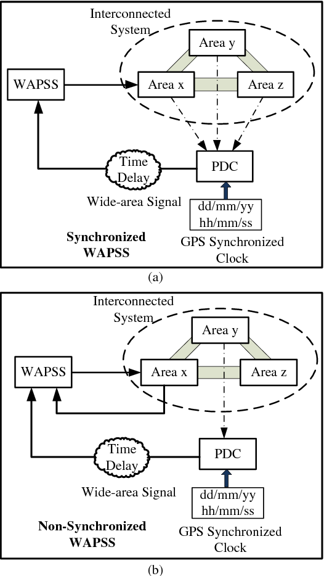
Block Diagram

Slide 10
SOFTWARE REQUIREMENTS:
Operating System : Windows 10
Platform : DOT NET TECHNOLOGY
Front End : ASP.Net 4.0
Back End : SQL SERVER 2014

Slide 11
HARDWARE REQUIREMENTS:
Keyboard
Mouse
Hard disk 500GB
Ram 4 Gb

Slide 12
CONCLUTION
This paper presents new results on time-delayed damping control of power system synchronous machine electromechanical oscillations. The paper shows that injecting delays in a PSS can, under certain conditions, significantly improve the dynamic response of the overall system. The paper focuses on the delay-control gain space, and studies the stability boundaries, as well as the relationship between the existence of delay-independent stability and connected stability domains in the system parameters Connected stable regions are obtained by employing a PSS with two control channels and indicate that best damping characteristics may be achieved for larger delay values. Connectedness in this context enables the utilization of a large range of stabilizing parameters without the system having to jump over destabilizing settings. Future work will focus on the application of domain knowledge like the property of passivity, see, e.g. [49], to benchmark the performance of passivity-based controllers.

Slide 13
REFERENCE
[1] H. Wu, H. Ni, and G. T. Heydt, “The impact of time delay on robust control design in power systems,” in Proc. IEEE Power Eng. Soc. Winter Meeting. Conf., Jan. 2002, pp. 1511–1516.
[2] J. W. Stahlhut, T. J. Browne, G. T. Heydt, and V. Vittal, “Latency viewed as a stochastic process and its impact on wide area power system control signals,” IEEE Trans. Power Syst., vol. 23, no. 1, pp. 84–91, Feb. 2008.
[3] F. Milano and M. Anghel, “Impact of time delays on power system stability,” IEEE Trans. Circuits Syst. I, Reg. Papers, vol. 59, no. 4, pp. 889–900, Apr. 2012.
[4] R. Sipahi, S.-I. Niculescu, C. T. Abdallah, W. Michiels, and K. Gu, “Stability and stabilization of systems with time delay,” IEEE Control Syst., vol. 31, no. 1, pp. 38–65, Feb. 2011.
[5] K. Pyragas, “Continuous control of chaos by self-controlling feedback,” Phys. Lett. A, vol. 170, no. 6, pp. 421–428, Nov. 1992.

Slide 14
[6] R. Sipahi and N. Olgac, “Complete stability robustness of third-order LTI multiple time-delay systems,” Automatica, vol. 41, no. 8, pp. 1413–1422, Aug. 2005.
[7] G. Stépán, Retarded Dynamical Systems: Stability and Characteristic Function. New York, NY, USA: Longman Scientific & Technical, 1989.
[8] C. T. Abdallah, P. Dorato, J. Benites-Read, and R. Byrne, “Delayed positive feedback can sabilize oscillatory systems,” in Proc. Amer. Control Conf., San Francisco, CA, USA, Jun. 1993, pp. 3106–3107.
[9] N. Olgac, A. F. Ergenc, and R. Sipahi, “‘Delay scheduling’: A new concept for stabilization in multiple delay systems,” J. Vib. Control, vol. 11, no. 9, pp. 1159–1172, 2005.
[10] A. Ramírez, R. Garrido, and S. Mondié, “Velocity control of servo systems using an integral retarded algorithm,” ISA Trans., vol. 58, pp. 357–366, Sep. 2015.

