Slide 1
Collaborative Cloud and Edge Mobile Computing in C-RAN Systems with Minimal End-to-End Latency

Slide 2
Abstract
Mobile cloud and edge computing protocols make it possible to offer computationally heavy applications to mobile devices via computational offloading from devices to nearby edge servers or more powerful, but remote, cloud servers. Previous work assumed that computational tasks can be fractionally offloaded at both cloud processor (CP) and at a local edge node (EN) within a conventional Distributed Radio Access Networ k (D-RAN) that relies on non-cooperative ENs equipped with oneway uplink fronthaul connection to the cloud. In this paper, we propose to integrate collaborative fractional computing across CP and ENs within a Cloud RAN (C-RAN) architecture with finitecapacity two-way fronthaul links.

Slide 3
Accordingly, tasks offloaded by a mobile device can be partially carried out at an EN and the CP, with multiple ENs communicating with a common CP to exchange data and computational outcomes while allowing for centralized precoding and decoding. Unlike prior work, we investigate joint optimization of computing and communication resources, including wireless and fronthaul segments, to minimize the end-to-end latency by accounting for a two-way uplink and downlink transmission. The problem is tackled by using fractional programming (FP) and matrix FP. Extensive numerical results validate the performance gain of the proposed architecture as compared to the previously studied D-RAN solution.

Slide 4
Existing System
To achieve this, the MNOs would be required to incur exceptionally high operational expenditures (OPEX) and capital expenditures (CAPEX) for deploying more base stations or maintaining and operating the existing stations.
In, a comprehensive assessment was carried out to compare the existing radio resource management schemes proposed for LTE/LTE-A femtocell and relay networks, in terms of interference mitigation, radio resource utilization, fairness, complexity, and QoS.
The complexity analysis of the algorithms and performance comparison with other existing schemes in terms of the QoS (number of expensive inter-cluster handover) and resource (RRH, hosts, and energy) consumption was demonstrated.

Slide 5
Disadvantage of Existing System
In, the authors tackled the optimization of functional split for collaborative computing systems equipped with a packet-based fronthaul network. In, the authors addressed the task allocation and traffic path planning problem for a C-RAN system under the assumption that the service latency consists of task processing delay and path delay only on fronthaul links.
To tackle the formulated problems, which turn out to be non-convex, we adopt fractional programming (FP) and matrix FP . We present extensive numerical results that confirm the convergence of the proposed optimization algorithms, the advantages of C-RAN architecture as compared to D-RAN, and the impact of collaborative cloud and edge computing on latency with C-RAN.

Slide 6
PROPOSED SYSTEM :
Several research works have proposed different methodologies for effective resource management in C-RAN.
This study performs a comprehensive survey on the state-of-the-art resource management techniques that have been proposed recently for this architecture.
The objective of resource management is to utilize the limited radio frequency spectrum resources and radio network infrastructure with maximum efficiency. Different resource allocation mechanisms have been proposed for efficient resource management in C-RAN.
They proposed a combined bin packing method (BPM) and modified the best fit decreasing (MFBD) algorithm to solve this problem.

Slide 7
ADVANTAGE
In a D-RAN, ENs perform local signal processing for channel encoding and decoding. Thus, the overall performance 2 can be degraded by interference in dense networks.
In this paper, we propose integrating collaborative fractional cloudedge offloading within a cloud radio access network (CRAN) architecture, while accounting for the contributions of both uplink and downlink. In a C-RAN, joint signal processing, in the form of cooperative precoding and detection, at the CP enables effective interference management.
We provide extensive numerical results in Sec. V to validate the performance gain of the proposed architecture as compared to the D-RAN solution.

Slide 8
TITTLE | AUTHOR | DESCRIPTION
A survey of mobile cloud computing: Architecture, applications, and approaches | H. T. Dinh, C. Lee, D. Niyato and P. Wang, | Together with an explosive growth of the mobile applications and emerging of cloud computing concept, mobile cloud computing (MCC) has been introduced to be a potential technology for mobile services.
The case for VM-based cloudlets in mobile computing | M. Satyanarayanan, P. Bahl, R. Caceres and N. Davies, | This article discusses the technical obstacles to these transformations and proposes a new architecture for overcoming them.

Slide 9
TITTLE | AUTHOR | DESCRIPTION
Joint optimization of radio and computational resources for multicell mobile-edge computing | S. Sardellitti, G. Scutari and S. Barbarossa, | In this paper, we consider an MIMO multicell system where multiple mobile users (MUs) ask for computation offloading to a common cloud server.
Joint uplink/downlink optimization for backhaul-limited mobile cloud computing with user scheduling | A. Al-Shuwaili, O. Simeone, A. Bagheri and G. Scutari, | In this paper, the design of a mobile cloud computing system is investigated by proposing the joint optimization of computing and communication resources with the aim of minimizing the energy required for offloading across all MUs under latency constraints at the application layer.

Slide 10
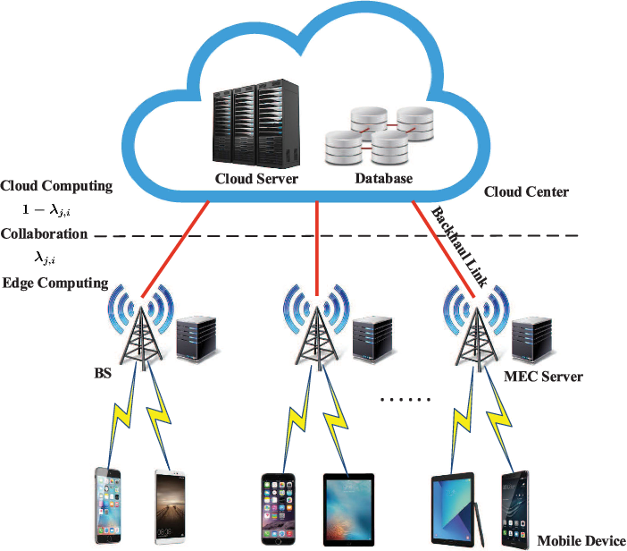
Block Diagram

Slide 11
SOFTWARE REQUIREMENTS:
Operating System : Windows 10
Platform : DOT NET TECHNOLOGY
Front End : ASP.Net 4.0
Back End : SQL SERVER 2014

Slide 12
HARDWARE REQUIREMENTS:
Keyboard
Mouse
Hard disk 500GB
Ram 4 Gb

Slide 13
CONCLUTION
We have studied the design of collaborative cloud and edge mobile computing within a C-RAN architecture for minimal end-to-end latency. We have tackled the joint design of computational resource allocation and C-RAN signal processing strategies with the goal of minimizing end-to-end latency required for completing the computational tasks of all the participating UEs in the network. To tackle the non-convex optimization problem, we have applied FP and matrix FP. Via extensive numerical results, we have validated the convergence of the proposed optimization algorithms, the performance gain of C-RAN architecture as compared to D-RAN, and the impact of optimized computational resource allocation of collaborative cloud and edge computing. As future work, we mention the extension to collaborative AR , heterogeneous C-RAN and mobile computing integrated systems , the robust design with imperfect CSI, and the energyefficient design for energy-limited mobile UEs. Also, it would be relevant to verify the effectiveness of the proposed algorithms by deriving a tight lower bound on the optimal latency values

Slide 14
REFERENCE
[1] H. T. Dinh, C. Lee, D. Niyato and P. Wang, "A survey of mobile cloud computing: Architecture, applications, and approaches," Wireless Commun. Mobile Comput., vol. 13, no. 18, pp. 1587–1611, Dec. 2013.
[2] M. Satyanarayanan, P. Bahl, R. Caceres and N. Davies, "The case for VM-based cloudlets in mobile computing," IEEE Pervasive Comput., vol. 8, no. 4, pp. 14–23, Oct. 2009.
[3] S. Sardellitti, G. Scutari and S. Barbarossa, "Joint optimization of radio and computational resources for multicell mobile-edge computing," IEEE Trans. Signal Inf. Process. Netw., vol. 1, no. 2, pp. 89–103, Jun. 2015.
[4] A. Al-Shuwaili, O. Simeone, A. Bagheri and G. Scutari, "Joint uplink/downlink optimization for backhaul-limited mobile cloud computing with user scheduling," IEEE Trans. Signal Inf. Process. Netw., vol. 3, no. 4, pp. 787–802, Dec. 2017.
[5] T. X. Tran, A. Hajisami, P. Pandey and D. Pompili, "Collaborative mobile edge computing in 5G networks: New paradigms, scenarios, and challenges," IEEE Commun. Mag., vol. 55, no. 4, pp. 54–61, Apr. 2017.

Slide 15
[6] P. Mach and Z. Becvar, "Mobile edge computing: A survey on architecture and computation offloading," IEEE Commun. Surveys Tuts., vol. 19, no. 3, pp. 1628–1656, 3rd.quart., 2017.
[7] S. Xiao, C. Liu, K. Li and K. Li, "System delay optimization for mobile edge computing," Future Generation Computer Systems, vol. 109, pp. 17–28, Aug. 2020.
[8] J. Ren, G. Yu, Y. He and G. Y. Li, "Collaborative cloud and edge computing for latency minimization," IEEE Trans. Veh. Technol., vol. 68, no. 5, pp. 5031–5044, May 2019.
[9] D. Huang, P. Wang and D. Niyato, "A dynamic offloading algorithm for mobile computing," IEEE Trans. Wireless Commun., vol. 11, no. 6, pp. 1991–1995, Jun. 2012.
[10] K. Kumar and Y. H. Lu, "Cloud computing for mobile users: Can offloading computation save energy?" Computers, vol. 43, no. 4, pp. 51–56, Apr. 2010.

