Slide 1
Attribute-Based Data Sharing Scheme Revisited in Cloud Computing

Slide 2
Abstract
Ciphertext-policy attribute-based encryption (CPABE) is a promising encryption technology for secure data sharing in cloud computing, in which data owner can fully control access structure associated with a ciphertext. However, it brings a major drawback which is known as key escrow problem, since the decryption users’ secret keys are issued by an unconditionally trusted third party (i.e. key authority). In addition, there is another problem that most of CP-ABE schemes cannot express arbitrary-state attributes. In this paper, we revisited attributebased data sharing scheme in order to solve the key escrow issue and improve the ability of attribute expression in cloud computing.

Slide 3
An improved two-party key issuing protocol ensures that neither key authority nor cloud service provider can generate the whole secret keys of users individually. Moreover, the function of weighted attribute is provided to enhance the attribute expression, which can not only extend attributes from binary state to arbitrary states, but also reduce the complexity of access policy associated with a ciphertext. Therefore, both ciphertext storage and time cost in encryption are saved. The performance analysis and security proof show that the proposed scheme is efficient to securely achieve data sharing in cloud computing.

Slide 4
Existing System
In our scheme, expensive bilinear pairing operation in KP-ABE replaces with point scalar multiplication on ECC and makes a lightweight data sharing scheme which is quite suitable for using in computationally limited devices such as smart phones.
Our proposed scheme also presents two important security requirements, user revocability and DoS attack resiliency.
Finally, we compare the lightweight feature of our scheme with the existing ABE schemes and show that it is more efficient and practical than others.
Since bilinear mapping and modular exponentiation are expensive operations, most of the existing RSA based ABE schemes suffer from high encryption and decryption overhead.

Slide 5
Disadvantage of Existing System
we propose an improved key issuing protocol to resolve the key escrow problem of CP-ABE in cloud computing.
The protocol can prevent KA and CSP from knowing each other’s master secret key so that none of them can create the whole secret keys of users individually.
Thus, the fully trusted KA can be semi-trusted in the proposed scheme. In this case, data confidentiality and privacy can be ensured.
we present weighted attribute to enhance the expression of attribute.
The weighted attribute can not only express arbitrary-state attributes instead of the traditional binary state, but also reduce the complexity of access policy.

Slide 6
PROPOSED SYSTEM :
A privacy aware smart health access control system (PASH) is proposed in, where a large universe CP-ABE scheme with partially hidden access policies is introduced to deal with both data security and user privacy issues.
It takes charge of computing corresponding private keys for users and publishes the keys among them. It also is responsible for revoking the users.
The AA is assumed to be honest but curious, that is, it will not deny services to any authorized users and it will correctly follow the proposed protocol, but it is curious about the data content and it would like to obtain as much private information as possible.

Slide 7
ADVANTAGE
We also observe that all experimental results are gradually increasing and approximately follow a linear relationship with the number of weighted attributes.
Therefore, with a small error tolerance, we estimate their limit values, where the mathematical expressions are computed by using the mean algorithm.
When N → ∞, the limit value of space saving in CP-WABE-RE scheme is approximately equal to 48.39% comparing to .
The cost is reduced by nearly half in theory which is consistent with the above efficiency analysis. Comparing with our scheme and, the saved storage cost is approximately 64.47% which matches the corresponding limit value in theory.

Slide 8
TITTLE | AUTHOR | DESCRIPTION
A survey on decentralized online social networks | T. Paul, A. Famulari, and T. Strufe, | Decentralized Online Social Networks (DOSNs) have recently captured the interest of users because of the more control given to them over their shared contents.
An efficient hybrid peer-to-peer system for distributed data sharing | M. Yang and Y. Yang, | The objective of this work is to design a hybrid peer-to-peer system for distributed data sharing which combines the advantages of both types of peer-to-peer networks and minimizes their disadvantages.

Slide 9
TITTLE | AUTHOR | DESCRIPTION
Privacypreserving public auditing for secure cloud storage | C. Wang, S. S. Chow, Q. Wang, K. Ren, and W. Lou, | To securely introduce an effective TPA, the auditing process should bring in no new vulnerabilities toward user data privacy, and introduce no additional online burden to user.
Ciphertext-policy attributebased encryption | J. Bethencourt, A. Sahai, and B. Waters, | In several distributed systems a user should only be able to access data if a user posses a certain set of credentials or attributes

Slide 10
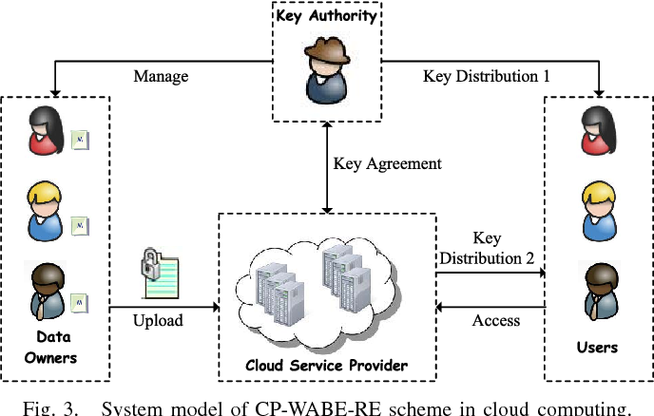
Block Diagram

Slide 11
SOFTWARE REQUIREMENTS:
Operating System : Windows 10
Platform : DOT NET TECHNOLOGY
Front End : ASP.Net 4.0
Back End : SQL SERVER 2014

Slide 12
HARDWARE REQUIREMENTS:
Keyboard
Mouse
Hard disk 500GB
Ram 4 Gb

Slide 13
CONCLUTION
In this paper, we revisited an attribute-based data sharing scheme in cloud computing. The improved key issuing protocol was presented to resolve the key escrow problem. It enhances data confidentiality and privacy in cloud system against the managers of KA and CSP as well as malicious system outsiders, where KA and CSP are semi-trusted. In addition, the weighted attribute was proposed to enhance the expression of attribute, which can not only describe arbitrarystate attributes, but also reduce the complexity of access policy, so that the storage cost of ciphertext and time cost in encryption can be saved. Finally, we presented the performance and security analyses for the proposed scheme, in which the results demonstrate high efficiency and security of our scheme.

Slide 14
REFERENCE
[1] T. Paul, A. Famulari, and T. Strufe, “A survey on decentralized online social networks,” Computer Networks, pp. 1–16, 2014.
[2] M. Yang and Y. Yang, “An efficient hybrid peer-to-peer system for distributed data sharing,” IEEE Transactions on Computers, vol. 59, no. 9, pp. 1158–1171, 2010.
[3] C. Wang, S. S. Chow, Q. Wang, K. Ren, and W. Lou, “Privacypreserving public auditing for secure cloud storage,” IEEE Transactions on Computers, vol. 62, no. 2, pp. 362–375, 2013.
[4] J. Bethencourt, A. Sahai, and B. Waters, “Ciphertext-policy attributebased encryption,” IEEE Symposium on Security and Privacy, pp. 321– 334, 2007.
[5] L. Cheung and C. Newport, “Provably secure ciphertext policy ABE,” Proceedings of the 14th ACM conference on Computer and communications security, pp. 456–465, 2007.

Slide 15
[6] B. Waters, “Ciphertext-policy attribute-based encryption: an expressive, efficient, and provably secure realization,” Public Key Cryptography– PKC, pp. 53–70, 2011.
[7] H. Deng, Q. Wu, B. Qin, J. Domingo-Ferrer, L. Zhang, J. Liu, and W. Shi, “Ciphertext-policy hierarchical attribute-based encryption with short ciphertexts,” Information Sciences, vol. 275, pp. 370–384, 2014.
[8] A. Balu and K. Kuppusamy, “An expressive and provably secure ciphertext-policy attribute-based encryption,” Information Sciences, vol. 276, pp. 354–362, 2014.
[9] Z. Zhou, D. Huang, and Z. Wang, “Efficient privacy-preserving ciphertext-policy attribute based encryption and broadcast encryption,” IEEE Transactions on Computers, vol. 64, no. 1, pp. 126–138, 2015.
[10] M. Chase and S. S. Chow, “Improving privacy and security in multiauthority attribute-based encryption,” Proceedings of the 16th ACM Conference on Computer and Communications Security, pp. 121–130, 2009.

