Slide 1
Novel L1 Regularized Extreme Learning Machine for Soft-sensing of an Industrial Process

Slide 2
Abstract
Extreme learning machine (ELM) is suitable for nonlinear soft sensor development. Yet it faces an over-fitting problem. To overcome it, this work integrates bound optimization theory with Variational Bayesian (VB) inference to derive novel L1 norm-based ELMs. An L1 term is attached to the squared sum cost of prediction errors to formulate an objective function. Considering the non-convexity and non-smoothness of the objective function, this work uses bound optimization theory, and constructs a proper surrogate function to equivalently convert a challenging L1 norm-based optimization problem into easy one. Then, VB inference is adopted for optimizing the converted problem. Thus an L1 norm-based ELM can be efficiently optimized by an alternating optimization algorithm with a proved convergence. Finally, a soft sensor is developed based on the proposed algorithm. An industrial case study is carried out to demonstrate that the proposed soft sensor is competitive against recent ones.

Slide 3
Existing System
There are two options available to meet the government's requirements: either building new high-performance facilities or enhancing the efficiency of existing plants by incorporating advanced monitoring and control techniques.
The first option is likely impossible due to the high capital investment needed for the construction of new WWTPs. Moreover, the required land for the construction of new wastewater treatment sites may not be readily available because of environmental restrictions.
In contrast, the GP model is transparent and can generate explicit equations that are very convenient for direct online implementation in the existing process information and control systems.

Slide 4
Disadvantage of Existing System
To overcome the shortage of judgment made experienced operators and workers, a new soft sensor method based on kernel semi-supervised ELM is proposed to identify ST in this paper.
We also propose a novel activation function to replace the Gaussian function to avoid the outlier weight imbalance problem.
The main framework of the IG-SSELM is presented as follows. First, Select the appropriate characteristics based on expert experience.
Priori information plays an important role in a determined classification problem. Generally speaking, the Gaussian kernel has a satisfactory result when the data are sampled from a Gaussian Mixture distribution.

Slide 5
PROPOSED SYSTEM :
To compare the proposed approaches with the traditional FD method, a principal component analysis (PCA) model was also developed.
By applying soft-sensors, the residual signal, i.e., the difference between estimated and measured VFA values, can be generated.
The soft-sensors update can be performed automatically or by its developer. To automatically update the softsensors variety of approaches have been proposed.
The proposed methodology provides a recursive minimization strategy to deal with missing values; it also offers kernel density estimation (KDE) to calculate the confidence interval.

Slide 6
ADVANTAGE
The main framework of the IG-SSELM is presented as follows. First, Select the appropriate characteristics based on expert experience. Then, utilize all the collected data (labelled and unlabeled data) to train our model with the proposed kernel activation function.
Finally, for evaluating the performance of IG-SSELM, which further applied ST identification to industrial aluminum reduction cell. The main advantage of IG-SSELM is described:
A novel kernel activation function is proposed in the ST identification model.
All the dataset (labelled and unlabeled data) was used in the training process which improves the accuracy.
Laplacian regularization is introduced to ELM for obtaining better robustness and generation ability.

Slide 7
TITTLE | AUTHOR | DESCRIPTION
Identification of superheat of aluminium electrolytic cell based on computer vision and expert rule Chinese Automation Congress (CAC) | Chen X F, Ying X F and Huang K K 2017 | Then, the color change feature is extracted according to the variation of the brightness value of the fire area of the sampling frame.
Calculation and control of equivalent superheat for 300kA prebake aluminium electrolysis | Zeng S, Li J, Wei Y, et al. 2010 | This paper also divided the cell status by three parameters which are temperature, superheat and aluminum level, on which the control charts were plotted and decision system was designed.

Slide 8
TITTLE | AUTHOR | DESCRIPTION
Semantic network based on intuitionistic fuzzy directed hyper-graphs and application to aluminium electrolysis cell condition identification | Chen Z, Li Y and Chen X 2017 | Knowledge polymorphism primarily reflects the fact that some knowledge is quantitative and some knowledge is qualitative
Extreme learning machine for regression and multiclass classification | Huang G B, Zhou H, Ding X, et al. 2012 | This paper shows that both LS-SVM and PSVM can be simplified further and a unified learning framework of LS-SVM, PSVM, and other regularization algorithms referred to extreme learning machine (ELM) can be built.

Slide 9
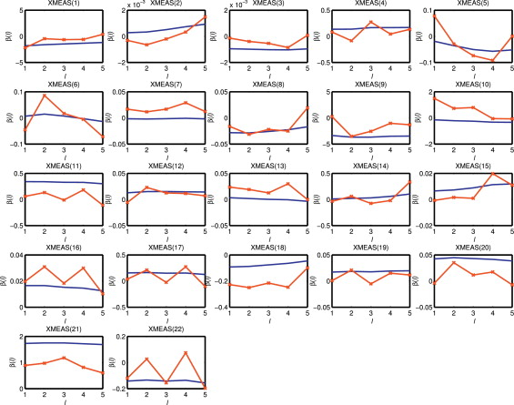
Block Diagram

Slide 10
SOFTWARE REQUIREMENTS:
Operating System : Windows 10
Platform : DOT NET TECHNOLOGY
Front End : ASP.Net 4.0
Back End : SQL SERVER 2014

Slide 11
HARDWARE REQUIREMENTS:
Keyboard
Mouse
Hard disk 500GB
Ram 4 Gb

Slide 12
CONCLUTION
A novel kernel, RAF, is proposed in this paper. The function can avoid the influence of the outlier dataset and avoid a lot of samples that tend to 0. Further, the IG kernel is extended to semi-supervised ELM and construct an IG-SSELM to deal with the uniform distribution and scarcity of labelled data samples. Meanwhile, IG-SSELM is further applied to the ST classification problem in the aluminium electrolysis to evaluate the performances. The experiment results illustrate that IG kernel function is superior to other popular kernel activation functions. At the same time, the accuracy ST identification is competent with other existing methods. The proposed IG-SSELM framework can be extended to other industrial domains.

Slide 13
REFERENCE
[1] Chen X F, Ying X F and Huang K K 2017 Identification of superheat of aluminium electrolytic cell based on computer vision and expert rule Chinese Automation Congress (CAC) (IEEE) pp 4705-4710.
[2] Zeng S, Li J, Wei Y, et al. 2010 Calculation and control of equivalent superheat for 300kA prebake aluminium electrolysis IEEE Intelligent Control and Automation pp 4755-4760.
[3] Chen Z, Li Y and Chen X 2017 Semantic network based on intuitionistic fuzzy directed hyper-graphs and application to aluminium electrolysis cell condition identification IEEE Access 5 20145-20156.
[4] Huang G B, Zhu Q Y and Siew C K 2006 Extreme learning machine: Theory and applications Neurocomputing 70 (1-3) 489-501.
[5] Huang G B, Zhou H, Ding X, et al. 2012 Extreme learning machine for regression and multiclass classification IEEE Transactions on Systems, Man and Cybernetics. Part B (Cybernetics) 42 (2) 513-529.

Slide 14
[6] Luo J, Vong C M and Wong P K 2017 Sparse Bayesian extreme learning machine for multi-classification IEEE Transactions on Neural Networks & Learning Systems 25 (4) 836-843.
[7] Wu J, Wang S and Chung F L 2011 Positive and negative fuzzy rule system, extreme learning machine and image classification Journal of Image and Graphics 2 (4) 261-271.
[8] He Q, Xin J, Du C, et al. 2014. Clustering in extreme learning machine feature space Neurocomputing 128 (5) 88-95.
[9] Belkin M, Niyogi P and Sindhwani V 2006 Manifold regularization: A geometric framework for learning from labelled and unlabelled examples Journal of Machine Learning Research 7 (1) 2399-2434.
[10] Lei Y, Chen X and Gui W 2019 Hessian regularization semi-supervised extreme learning machine for superheat identification in aluminum reduction cell Chinese Control and Decision Conference (CCDC) (IEEE) pp 4406-4411.

