Slide 1
A Confidence-Aware Machine Learning Framework for Dynamic Security Assessment

Slide 2
Abstract
Dynamic Security Assessment for the future power system is expected to be increasingly complicated with the higher level penetration of renewable energy sources and the widespread deployment of power electronic devices, which drive new dynamic phenomena.
As a result, the increasing complexity and the severe computational bottleneck in real time operation encourages researchers to exploit machine learning to extract offline security rules for the online assessment.
However, traditional machine learning methods lack in providing information on the confidence of their corresponding predictions.
Understanding better the confidence of the prediction made is of key importance for Transmission System Operators (TSOs) to use and rely on these machine learning methods.

Slide 3
Specifically, from the perspective of topological changes, it is often unclear whether the machine learning model can still be used.
Hence, being aware of the confidence of the prediction supports the transition to use machine learning in real time operation.
In this paper, we propose a novel Conditional Bayesian Deep Auto-encoder (CBDAC) based security assessment framework to compute a confidence metric of the prediction.
This informs not only the operator to judge whether the prediction can be trusted, but it also allows for judging whether the model needs updating.

Slide 4
Existing System
In this study, we start showing how existing approaches fail to detect alarms in some cases when not accounting for class imbalances.
We proceed by showing that both proposed approaches are able to drive system operation much closer to the global optimum than existing approaches, while also abiding to the user-defined risk tolerance level.
Moreover, we show that the proposed risk-averse approach is capable of identifying cost-effective control actions under a large range of unseen operation conditions.

Slide 5
Disadvantage of Existing System
Training of a neural network involves solving a nonlinear optimization problem where the goal is to minimize an error function depending on the type of network chosen.
Different gradient techniques are available online which are chosen during the training phase to reduce the problems that arise due to prsence of local minima.
In this study, the gradient descent method has been used in order to solve the optimization problem.

Slide 6
PROPOSED SYSTEM :
This work proposes to use machine learning for probabilistic security assessment including dynamic security.
A probabilistic framework is proposed that combines the strength of conventional security assessment methods with the strength of machine learning for realtime operation.
This overcomes the technical challenge of the computational complexity of assessing dynamic security in realtime operation, typically resulting in probabilistic security assessments mainly focusing on static security and not on dynamic security

Slide 7
ADVANTAGE
The proposed scheme of using seasonal load has proved that under the same set of contingencies for a different season, the number of violations differ. Therefore, there is a need to include seasonal variability while doing DSA.
The performance of RF was found to be the best among all algorithms when measurement errors were not considered in the study.
Substantial degradation in performance of RF was observed when measurement errors were introduced into the system.
The performance of SVM was better than the other algorithms considered in the study when measurement errors were fed into the testing models.

Slide 8
TITTLE | AUTHOR | DESCRIPTION
Next-Generation Monitoring, Analysis, and Control for the Future Smart Control Center | P. Zhang, F. Li and N. Bhatt, | The paper first reviews the present control center technology and then presents the vision of the next-generation monitoring, analysis, and control functions.
A New Measurement Technique for Tracking Voltage Phasors, Local System Frequency, and Rate of Change of Frequency | A. Phadke, J. Thorp, and M. Adamiak, | This paper describes the theoretical basis of these computations and describes results of experiments performed in the AEP power system simulation laboratory.

Slide 9
TITTLE | AUTHOR | DESCRIPTION
Wide-Area Monitoring, Protection, and Control of Future Electric Power Networks | V. Terzija et al., | Wide-area monitoring, protection, and control (WAMPAC) involves the use of system-wide information and the communication of selected local information to a remote location to counteract the propagation of large disturbances.
PMU-Based Wide Area Damping Control of Power Systems | H. Wu, Q. Wang and X. Li, | The wide area signal inputs to the local power system stabilizer (PSS) to regulate the generator excitation and enhancing the power system damping.

Slide 10
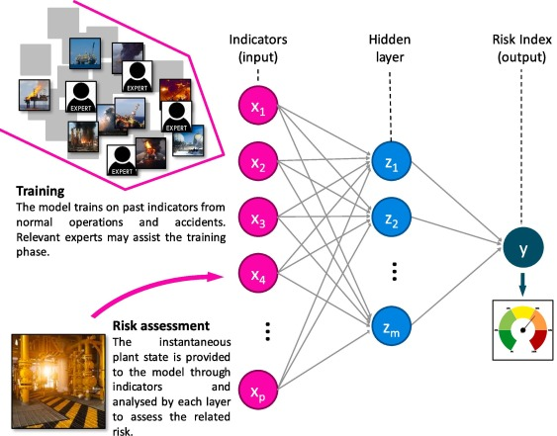
Block Diagram

Slide 11
SOFTWARE REQUIREMENTS:
Operating System : Windows 10
Platform : DOT NET TECHNOLOGY
Front End : ASP.Net 4.0
Back End : SQL SERVER 2014

Slide 12
HARDWARE REQUIREMENTS:
Keyboard
Mouse
Hard disk 500GB
Ram 4 Gb

Slide 13
CONCLUTION
The proposed scheme of using seasonal load has proved that under the same set of contingencies for a different season, the number of violations differ. Therefore, there is a need to include seasonal variability while doing DSA. With the inclusion of renewables in the study, for the same contingency scenarios, variations in transient stability and voltage security violations arise for systems which have renewable penetration and for systems having only conventional generation. Thus, renewable penetration must be taken into account while performing DSA. The performance of RF was found to be the best among all algorithms when measurement errors were not considered in the study. Substantial degradation in performance of RF was observed when measurement errors were introduced into the system.

Slide 14
REFERENCE
[1] U.S.-Canada Power System Outage Task Force, “Final Report on the August 14, 2003 Blackout in the United States and Canada: Causes and Recommendations,” U.S. Department of Energy, Washington DC, USA, Tech. Rep. April, 2004.
[2] European Commission, “A Roadmap for moving to a competitive low carbon economy in 2050,” 2011.
[3] P. Zhang, F. Li and N. Bhatt, "Next-Generation Monitoring, Analysis, and Control for the Future Smart Control Center," in IEEE Transactions on Smart Grid, vol. 1, no. 2, pp. 186-192, Sept. 2010.
[4] A. Phadke and J. Thorp, Synchronized Phasor Measurements and Their Applications. Springer Verlag, 2008
[5] A. Phadke, J. Thorp, and M. Adamiak, “A New Measurement Technique for Tracking Voltage Phasors, Local System Frequency, and Rate of Change of Frequency,” IEEE Transactions on Power Apparatus and Systems, vol. 102, no. 5, pp. 1025–1038, May 1983.

Slide 15
[6] V. Terzija et al., "Wide-Area Monitoring, Protection, and Control of Future Electric Power Networks," in Proceedings of the IEEE, vol. 99, no. 1, pp. 80-93, Jan. 2011.
[7] H. Wu, Q. Wang and X. Li, "PMU-Based Wide Area Damping Control of Power Systems," 2008 Joint International Conference on Power System Technology and IEEE Power India Conference, New Delhi, 2008, pp. 1-4.
[8] I. Kamwa, R. Grondin and Y. Hebert, "Wide-area measurement based stabilizing control of large power systems-a decentralized/hierarchical approach," in IEEE Transactions on Power Systems, vol. 16, no. 1, pp. 136-153, Feb 2001.
[9] P. Kundur et al., "Definition and classification of power system stability IEEE/CIGRE joint task force on stability terms and definitions," in IEEE Transactions on Power Systems, vol. 19, no. 3, pp. 1387-1401, Aug. 2004.
[10] Nerc planning standards (1997, sept.)...” http://www.nerc.com/~filez/pss-psg.html. Accessed: 2017-34-19.

